Slide 1



MI Options Medicare Assistance Program | State Health Insurance Assistance Program (SHIP)
Medicare 101 2026

Slide 2


Helping Seniors and Their Families
AgeWays Nonprofit Senior Services
Nonprofit with a wide variety of programs, services and supports to help older adults and their families in our 6-county region
Serve: Livingston, Macomb, Monroe, Oakland, St. Clair and Washtenaw counties
Two separate Area Agencies on Aging serving SE Michigan designated for Wayne county
800-852-7795
AgeWays.org

Slide 3



Programs That Can Help:
Information and Assistance
Free phone help line for seniors and their families. Call today: 800-852-7795
See if you qualify for one of our programs or get referrals to other programs.
First place to call when you or a loved one need help.

Slide 4
What is Medicare?
Health insurance for three groups of people
65 and older
Under 65 with certain disabilities
Any age with End-Stage Renal Disease (ESRD)
Administration
Centers for Medicare & Medicaid Services (CMS)
Enrollment
Social Security Administration (SSA) for most
Railroad Retirement Board (RRB) for railroad retirees

Slide 5

Welcome to Medicare
First mailing you will get from Medicare
Includes a letter, booklet and Medicare card
It’s sent to people who:
  Go to SSA to sign-up for Medicare
  First sign up for SSA retirement benefits (age 65 or older)
  Automatically get Medicare with less than 3 months before coverage starts (usually people under 65 with certain disabilities
  It will generally arrive 2 weeks after you sign up for Medicare or Social Security (if disabled, 2 weeks after SSA approves your benefits)

Slide 6
How to Enroll in Medicare
Enrollment is not automatic
If you don’t get Social Security or RRB benefits
For instance, you are still actively working
Enroll with Social Security
Visit local office
Call 1-800-772-1213
Online at ssa.gov
If retired from Railroad enroll with RRB
Call your local RRB office or 1‑877‑772‑5772
Notes:
If someone is not getting Social Security or Railroad Retirement Board benefits (for instance, because you are still working), they will need to sign up for Part A. They should contact Social Security 3 months before turning age 65. If they worked for a railroad, contact the RRB to sign up.
While Medicare is administered by the Centers for Medicare & Medicaid Services (CMS), the Social Security Administration (SSA) is responsible for enrolling most people in Medicare. The Railroad Retirement Board (RRB) is responsible for enrolling railroad retirees in Medicare.

Slide 7
Medicare Card
Front
Keep it and accept
Back
Return it to refuse Part B
Follow instructions
Medicare Parts A and B
on back of card
Notes:
The Original Medicare Card is red, white, and blue and it is used when a beneficiary gets health care. The Medicare card shows the Medicare coverage Part A and Part B date the coverage starts. Note: The card may look slightly different from this one; it’s still valid.
The Medicare card also shows your Medicare claim number.
If you choose another Medicare health plan, your plan may give you a card to use when you get health care services and supplies.
You should contact Social Security, if any information on the card is incorrect.
If you don’t want Part B, follow the directions and return the card.

Slide 8

A Few Definitions
Premium: the amount you pay for an insurance policy, generally monthly
Deductible: the amount you pay for out-of-pocket costs for health care before your plan begins to pay
Co-Pay: the rate (dollar amount) you pay for prescriptions, doctors visits, etc.
Co-Insurance: a percentage that you pay after you meet your deductible
Cost-Share: the amount you pay out-of-pocket including deductibles, co-pays and co-insurance, but NOT premiums.
Notes:
Before we move forward, I want to go through a few definitions. You have all probably heard these terms before, and you will hear them in the rest of the presentation, so I want to be sure everyone has a good working definition to help in their understanding.
Starting on pay 117 in the Medicare & You booklet, there are definitions of many of the terms you may come across. These are just some of the most important for the purposes of this presentation.

Slide 9
The Four Parts of Medicare
Part A
Hospital Insurance
Part B Medical Insurance
Part C Medicare Advantage (HMOs and PPOs)
Part D Medicare Prescription Drug Coverage
Notes:
Medicare has four parts:
Part A is Hospital Insurance
Part B is Medical Insurance
Part C is Medicare Advantage which are plans like HMOs and PPOs
Part D is Medicare Prescription Drug Coverage

Slide 10
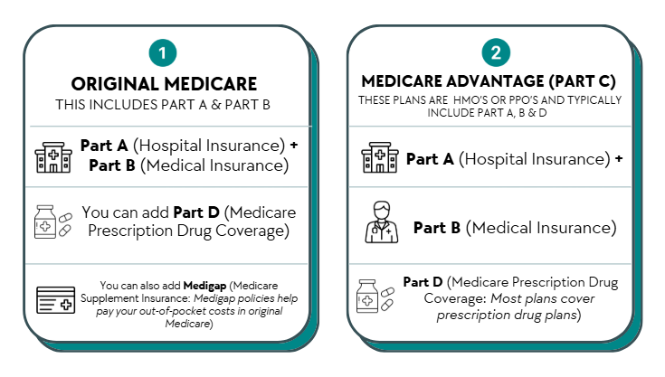
Your Medicare Choices
Notes:
When you first enroll in Medicare and during certain times of the year, you can choose how you get your Medicare coverage.
There are 2 main ways to get Medicare:
Original Medicare:
Original Medicare includes Medicare Part A and Part B.
If you want drug coverage, you can join a separate Medicare drug plan (Part D).
To help pay your out-of-pocket costs in Original Medicare (like your 20% coinsurance), you can also shop for and buy supplemental coverage. Medigap plan
Can use any doctor or hospital that takes Medicare, anywhere in the U.S.
Medicare Advantage (also known as Part C):
Medicare Advantage is an “all in one” alternative to Original Medicare. These “bundled” plans include Part A, Part B, and usually Part D.
Plans may have lower out-of-pocket costs than Original Medicare.
In many cases, you’ll need to use doctors who are in the plan’s network.
Most plans offer extra benefits that Original Medicare doesn’t cover—like vision, hearing, dental, and more.

Slide 11


Original Medicare (Parts A &B)
Has Part A: Hospital Insurance
  Hospital inpatient care
  Skilled Nursing Facility
  Home health care
  Hospice care
  $1,676 deductible (estimate $1716 in 2026)
Has Part B: Medical Insurance
  Doctor’s visits
  Outpatient hospital services
  Clinical lab tests
  Durable Medical Equipment
  Preventive services
  $257 deductible (estimate $288 in 2026)
  $185 monthly premium (estimate $206.50 in 2026)
NOTE: Original Medicare DOES NOT cover vision, dental or hearing, or medications
Notes:
Medicare Part A, hospital insurance helps pay for medically necessary services.
Hospital inpatient care - Semi-private room, meals, general nursing, and other hospital services and supplies, including in-patient psychiatric care.
Skilled nursing facility (SNF) care (not custodial or long-term care) when certain conditions are met.
Home health
Hospice Care
Blood as an inpatient
Medicare Part B covers a number of medically-necessary services and supplies. Certain requirements must be met.
Doctors’ Services
Outpatient Medical and Surgical Services.
Home Health Care Services
Durable Medical Equipment
Preventive Services like exams, lab tests, screening and shots to help prevent, find, or manage a medical problem. Preventive services may find health problems early when treatment works best.

Slide 12

What is Part D?
Optional Medicare prescription drug coverage
Provided by private insurance companies
You must choose and join plan
Plans have formularies (lists of covered drugs)
You pay the drug plan a monthly premium
You may have deductibles and copayments
Notes:
While technically, Part D is optional, in most cases, there are penalties to not getting it.
Part D is the most complicated Part of enrolling in Medicare. It involves researching plans, comparing prices and more. MMAP counselors are trained to assist beneficiaries and take the stress out of enrolling.
People with limited income and resources may be able to get Extra Help to help pay for their Medicare drug plan.

Slide 13
Joining a Part D Plan
New to Medicare
7 month initial enrollment period
Annual fall open enrollment
October 15 – December 7
Coverage starts January 1
Special Enrollment Periods
Low income, involuntary loss of credible coverage, moved outside of plan’s service area, etc.
Ways to join
Call us 248-262-0545
Call the Plan directly
Visit Medicare.gov
Call 1-800-Medicare
Notes:
You can join a Medicare Prescription Drug Plan when you first become eligible for Medicare, which begins 3 months before your first entitlement to both Medicare Part A and Part B. After you enroll in a Medicare Prescription Drug Plan you must remain with that plan for the rest of the calendar year.
You can also enroll in a Medicare Part D plan annually during opened enrollment from October 15 – December 7.
There are also times when one can disenroll or get a special enrollment period, too lengthy to address in this presentation. All of this is covered in “Medicare and You,” which is provided to all Medicare beneficiaries every year. We can also make copies available to you.

Slide 14
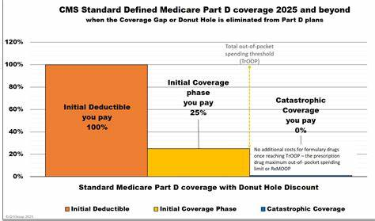
2025 Medicare Part D Phases
2026 TrOOP- $2100.00
$590
Notes:
This slide illustrates how much you will pay for your medications at various points in time. So once you pay $590, you will pay 25% of the cost of medications. Once you hit $2,000, you will not pay anything.
So… if you are paying a maximum of $2,000 out of pocket for your medications, who is picking up the rest of the price? The next slide will provide some detail on this.

Slide 15
IMPORTANT!
Only medications that are on your plan formulary count towards out-of-pocket. Over-the-counter drugs do not count, nor do prescription medications purchased without going through your insurance (for example, GoodRX)—even if they are on the formulary
Plan Premiums also do not count towards your out-of-pocket expenses
Plans may choose to not cover medications that are prescribed for “off-label” use, even if the medication is on the formulary
Notes:
For example, Gabapentin may be on your plan for postherpetic neuralgia, but your doctor may prescribe it for sleep disorders. As this drug is not FDA approved for sleep disorders, your plan may choose to not cover it or may require prior authorization. If the plan does not approve the off-label use of the medication, you will be stuck with the entire cost, and it will not cost towards your $2,000 deductible, or as part of coverage after you meet your deductible. This is just an example.
I will speak more about this a little later when we discuss weight loss drugs.

Slide 16
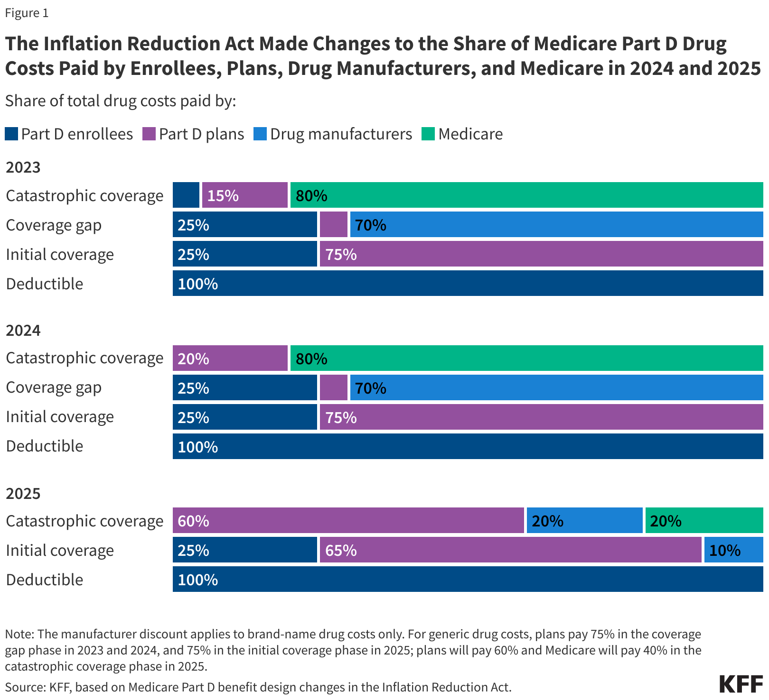
Who is Paying for Medicare?
Notes:
This slide shows the change over the last 3 years as to who is providing what coverage for prescription medications.
Like in 2023 and 2024, you will pay 100% of the cost of medications until you reach the deductible of $590. In 2025, when you enter the initial coverage phase drug manufacturers are now having to pay 10%, reducing the cost to the plans by the same amount.
And, once you reach catastrophic coverage with $2,000 in out-of-pocket expenses, where you would previously pay 20% and Medicare would pay 80%, you will now not pay anything, the plans will pay 60%, the drug manufacturers will pay 20% and Medicare will pay 20%.
Many people will not feel the effects of these changes, but for people who take expensive medications, this can truly be life changing

Slide 17
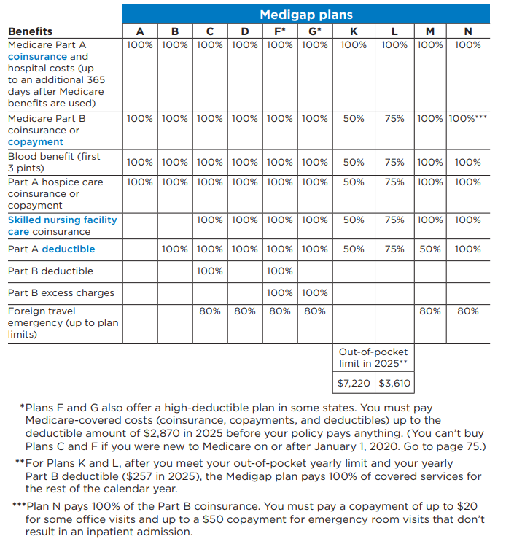
What is Medigap?
Policies sold by private companies
Fills the gaps in Original Medicare
  Deductibles, coinsurance, copayments
All plans with same letter have same coverage
  Costs are the major difference
Not all plans are offered to people under 65 with a disability
Notes:
Medigap (Medicare Supplement Insurance) policies are private health insurance that cover the policyholder. They are sold by private insurance companies to supplement Original Medicare (help pay for “gaps” in Original Medicare coverage - like deductibles, coinsurance and copayments)
They pay for Medicare-covered services provided by any doctor, hospital, or provider that accepts Medicare
They must follow Federal and state laws that protect people with Medicare.
Some Medigap plans are now offering various riders for services such as vision, dental and hearing. These riders come at a cost to the beneficiary and also come with various restrictions.
The next slide details what different Medigap plans cover. It is important to note that all plans with the same letter must offer the same services at the same percentages. This is aside from any riders they may choose to offer.

Slide 18
Part C Medicare Advantage
Medicare Advantage
Health plans approved by Medicare (PPOs and HMOs) run by private Insurance Companies
Includes Parts A & B and usually Part D
Medicare pays amount for each member’s care
Most plans include some dental, vision and hearing coverage
May have to use network doctors or hospitals
Notes:
Medicare Advantage is also called Part C. They are
Health plan options approved by Medicare
Run by private companies
Either an HMO or a PPO
Medicare pays amount for each member’s care
Advantage plans are another way to get Medicare coverage
You may have to use network doctors or hospitals although most PPOs have an out-of-network option. Costs may be slightly higher than the in-network option
It is important to make sure the doctors you choose are in-network, or that your plan has an out-of-network option that you are ok with. And just like choosing a Part D plan, it is essential that check if your medications are all on the plan formularies.

Slide 19

New in 2025
Medicare Advantage Plans must send notice mid-year to beneficiaries of unused benefits, including but not limited to:
Vision
Dental
Hearing
Fitness
OTC-Purchasing Cards

Slide 20

Joining a Part C Medicare Advantage Plan
During 7-month initial enrollment period
Can join during Annual fall open enrollment
  October 15 – December 7 each year
  Coverage begins January 1
Open Enrollment Period for MA Plans: January-March
Enroll today!
  Call us at 248-262-0545 or our Statewide Call Center 1-800-803-7174
  Call Medicare 1-800-Medicare or visit Medicare.gov
Notes:
You can join a Medicare Advantage Plan when you first become eligible for Medicare. during OEP – October 15- December 7.
Also from January 1 – March 31. You can switch to a different Medicare Advantage Plan. The coverage will become active the following month after enrollment.

Slide 21
IMPORTANT!
If you are still working after 65, even if you are taking Social Security, you DO NOT necessarily need to enroll in Medicare.
If you are collecting Social Security you will automatically be enrolled in Parts A & B. Most people choose to keep Part A.
If you have qualifying health insurance through your employer, you can refuse Part B (There are no late enrollment penalties provided you have qualifying (creditable) coverage)
When you are ready to take Medicare you will need some paperwork to be sent to the Social Security Administration. Your HR people should be familiar with this process

Slide 22
A Few Things to Consider if You Work Past Age 65
Be sure you are aware of all relevant dates and deadlines. There are life-long penalties for enrolling late in both Part B and Part D
If you delay enrollment in Part B, you must get proof of creditable coverage from your employer in order to avoid a penalty
If you get your health insurance through your spouse, you will need to check with their benefits coordinator for health insurance to make sure you have creditable coverage

Slide 23

What are Health Savings Accounts? (HSA)
Accounts for individuals with high-deductible health plans (HDHPs)
Funds are not taxed to deposit or withdraw
In order to deposit you must have an HDHP and have no other insurance (including Medicare)
Notes:
Health Savings Accounts (HSAs) are accounts for individuals with high-deductible health plans (HDHPs). Funds contributed to an HSA are not taxed when put into the HSA or when taken out as long as they are used to pay for qualified medical expenses. Your employer may oversee your HSA, or you may have an individual HSA that is administered by a bank, credit union, or insurance company.

Slide 24
Medicare & Health Savings Accounts (HSA)
Enrolling in Medicare Parts A and/or Part B
You can not contribute pre-taxed dollars to HSA
Stop contributing the month your Medicare coverage begins
Can withdraw tax-free to pay qualified medical expenses
Medicare pays primary to the job-based coverage
Delaying enrollment into Parts A and Part B
Receiving health coverage from an employer with 20+ employees and
Want to continue putting funds into HSA tax-free
Can use a special enrollment period to enroll in Medicare
Stop contributing to HSA at least 6 months before you enroll in Medicare
Notes:
If you have an HSA and will soon be eligible for Medicare, it is important to understand how enrolling in Medicare will affect your HSA.
High-deductible health plans
In order to qualify to put money into an HSA, you must:
be enrolled in a high-deductible health plan and
may not have any other health insurance (including Medicare or coverage from a spouse or family member).
HDHPs have large deductibles that members must meet before receiving coverage. This means HDHP members pay in full for most health care services until they reach their deductible for the year. Afterwards, the HDHP covers all the member’s costs for the remainder of the year.
Enrolling in Medicare when you have an HSA
If you enroll in Medicare Part A and/or B:
you can no longer contribute pre-tax dollars to your HSA because, with an HSA, you cannot have any health insurance other than an HDHP.
The month your Medicare begins, you should stop contributing to your HSA.
However, you may continue to withdraw money from your HSA after you enroll in Medicare to help pay for medical expenses, such as deductibles, premiums, copayments, and coinsurances.
If you use the account for qualified medical expenses, its funds will continue to be tax-free.
Whether you should delay enrollment in Medicare so you can continue contributing to your HSA depends on your circumstances.
Health coverage from an employer with 20 or more employees pays primary to Medicare, so you may choose to delay Medicare enrollment if you work at this kind of employer and continue putting funds into your HSA, but you must delay BOTH Medicare Part A and Part B to do so.
Note: In either case, you will be able to enroll in Part A and will have access to the Part B Special Enrollment Period (SEP) when you lose coverage or retire.
If you choose to delay Medicare Part A and Part B enrollment because you are still working and want to continue contributing to your HSA, you must also wait to collect Social Security retirement benefits. This is because most individuals who are collecting Social Security benefits when they become eligible for Medicare are automatically enrolled into Medicare Part A. You cannot decline Part A while collecting Social Security benefits.
The takeaway here is that you should delay Social Security benefits and decline Part A if you wish to continue contributing funds to your HSA.
Finally, if you decide to delay enrolling in Medicare, make sure to stop contributing to your HSA at least six months before you do plan to enroll in Medicare. This is because when you enroll in Medicare Part A, you receive up to six months of retroactive coverage, not going back farther than your initial month of eligibility. If you do not stop HSA contributions at least six months before Medicare enrollment, you may incur a tax penalty.
If you require counseling around HSAs, consult a tax professional.

Slide 25

Income Related Medicare Adjustment Amount (IRMAA)
Part D Premiums are subject to income adjustments
Beneficiaries with significant income will pay a sliding scale higher Part D premiums (based on IRS tax returns from 2 years prior)
There are 6 income categories
Each category has a set dollar amount associated with it
Notes:
Health Savings Accounts (HSAs) are accounts for individuals with high-deductible health plans (HDHPs). Funds contributed to an HSA are not taxed when put into the HSA or when taken out as long as they are used to pay for qualified medical expenses. Your employer may oversee your HSA, or you may have an individual HSA that is administered by a bank, credit union, or insurance company.

Slide 26
2025 Part B IRMAA
Individual tax filers with income: | Joint tax filers with income: | IRMAA for Part B
< $106,000 | $212,000 | $0
$106,00 to $133,000 | $212,000 to $266,000 | $259.00
> $133,000-$167,000 | >$266,001 to $336,000 | $370.00
$167,000 to $200,000 | >$334,000 to $400,000 | $480.90
>$200,000 to <$500,000 | >$366,001to $750,000 | $591.90
Above $500,000 | Above $750,000 | $628.90
Notes:
These are the 2025 IRMAA numbers; the income thresholds will be adjusted each year by increasing the previous year’s income threshold amounts by the consumer price index for urban consumers.
Sec. 402—Income-Related Premium Adjustment for Parts B and D
Beginning in 2018, this provision would make adjustments to the current laws’ income-related premium policy. This provision adjusts the amounts of the income thresholds for applying the income-related premium as shown on the above table.
Beginning in 2020, the income thresholds would be adjusted each year by increasing the previous year’s income threshold amounts by the consumer price index for urban consumers (CPI-U).

Slide 27
2025 Part D IRMAA
Individual tax filers with income: | Joint tax filers with income: | IRMAA for Part D
< $106,000 | $212,000 | $0
$106,01 to $133,000 | $212,001 to $266,000 | $13.70 + Plan Premium (PP)
$133,001-$167,000 | $266,001 to $336,000 | $35.30 + PP
$167,001 to $200,000 | $336,001 to $400,000 | $57.00 + PP
$200,001 to $500,000 | $400.001 to $750,000 | $78.60 + PP
Above $500,000 | Above $750,000 | $75.80 + PP
Notes:
These are the 2025 IRMAA numbers; the income thresholds will be adjusted each year by increasing the previous year’s income threshold amounts by the consumer price index for urban consumers.
Sec. 402—Income-Related Premium Adjustment for Parts B and D
Beginning in 2018, this provision would make adjustments to the current laws’ income-related premium policy. This provision adjusts the amounts of the income thresholds for applying the income-related premium as shown on the above table.
Beginning in 2020, the income thresholds would be adjusted each year by increasing the previous year’s income threshold amounts by the consumer price index for urban consumers (CPI-U).

Slide 28
Help For People With Limited Income and/or Resources
Extra Help (with prescription drugs)
Medicaid
Medicare Savings Programs
Pharmaceutical Assistance Programs
Prescription Savings Cards
Notes:
There are programs available to help people with limited income and resources pay their Medicare costs. These include Medicaid, Extra Help, and Medicare Savings Programs. If you think you might qualify or need help, call MMAP and we will set up a private appointment with you.

Slide 29
Enroll on Time!
There are life-long penalties that will follow you if you miss the deadlines for Part D and/or B.
Part B Late Enrollment Penalty is 10% of the Standard Monthly Premium for each month you should have enrolled but didn’t
So, if you should have enrolled in October of 2023, and decide to enroll during the General Enrollment Period in January of 2026, you will pay an additional $41.30 a month on top of the $206.50 Part B Premium
As the Premium changes (generally goes up) every year, so will the amount you pay as a penalty
Part D Late Enrollment Penalty Calculation: Penalty is calculated as 1% of the Part D base beneficiary premium ($36.78 in 2025. Estimated $38.99 in 2026)
For each month a beneficiary does not have creditable coverage and is not enrolled in Part- D (approximately `$0.36 a month x the number of months, added to the monthly premium)
The penalty amount changes each year as the Part D base beneficiary premium changes
Notes:
As an example, if you don’t sign up for Part D for 5 years, you will now have an additional $4.32 a year added on to your Part D premium, x 5 years, which would be $21.60 a month additional added on to whatever premium your plan is charging.
Something we frequently hear is that “I must sign-up when I turn 65 or I will have penalties.” This is basically true, but there are other times people can enroll, depending on their circumstances. A quick conversation with a MMAP counselor can provide you with information on your specific situation.

Slide 30

Special Enrollment Periods (SEPs)
Enable beneficiaries to make Part D changes in special situations, including:
  Involuntary loss of creditable coverage
  Entering, residing in or leaving a long-term care facility
  Moving
  Other exceptional circumstances
    Automatic enrollment into a plan by Medicare
    Error by a Federal Employee
    First year trial period for Medicare Advantage
    Switching to/from PACE (Program of All-Inclusive Care for the Elderly)
    When an employer group health plan would otherwise allow a beneficiary to make changes to his/her employer group health plan.
  NOTE: COBRA is not considered creditable coverage for Medicare Part B. You may qualify for a Part D Special Enrollment Period, but not in all cases.
Notes:
There are some circumstances in which people with Medicare are given a Special Enrollment Period (SEP).
NOTE on loss of creditable coverage: A beneficiary is not entitled to a SEP if he/she loses coverage due to non-payment of premiums. If a beneficiary was not adequately informed that his/her coverage was not creditable, or that his/her current coverage was reduced so that it is no longer creditable, then the beneficiary will qualify for a SEP.
Other special enrollment circumstances:
There may be reasons why you should take Medicare drug coverage instead of, or in addition to, COBRA. If you take COBRA and it includes creditable prescription drug coverage, you'll have a special enrollment period to join a Medicare drug plan without a penalty when COBRA ends.
Contact us if you thing you might qualify for an SEP. We will help you figure it out.

Slide 31

A Brief Word About “Creditable Coverage”
Creditable coverage is coverage that is at least as good as what Medicare provides. However, with the $2,000 cap on medications, many businesses may find that the plans they are offering no longer are “at least as good,” as they may have, for example, a $3,000 cap on medications.
To resolve this, CMS has stated that if a plan was considered creditable in 2024, it will still be considered creditable in 2025, so as to avoid a major problem. What will happen in 2026 will be determined later in the year.
Notes:
You should receive a notice from your plan indicating if it is considered creditable.

Slide 32
Medicare Advantage
Special Needs Plans (SNPs)
SNPs or Special Plans are PPOs and HMOs that may offer more benefits (and at possibly a lower cost) to Medicare beneficiaries.
There are plans for people with lower incomes, called D-SNPs (for Dually enrolled Medicare and Medicaid beneficiaries)
There are plans for people with certain chronic conditions, called C-SNPs
  Diabetes and Heart Disease, End-Stage Renal Diseases and HIV/AIDS are a few of the Chronic conditions where C-SNPs are available in Michigan
There are plans for people residing in institutions, who require a level of care provided by long term care facilities called I-SNPs
Notes:
On Medicare.gov plan finder, SNPs are also called Special Plans. The reason is that Medicare wants to insure that people at all income levels know that they are eligible for the C-SNPs if they have a qualifying chronic condition.

Slide 33
IMPORTANT!
  DON’T DO IT ALONE! If you are interested in a SNP, it is very important that you educate yourself and talk to a counselor. It can be complicated to navigate the myriad of programs and services that are available. There are also strict rules about applying for, and changing plans that need to be understood and followed.

Slide 34

Healthcare Marketplace and Medicare
Marketplace and Medicare not designed to work together
When you become eligible for Medicare, you should drop Marketplace in favor of Medicare
If you do not enroll in Medicare, you may:
  Lose tax credits for Marketplace
  Be penalized for not enrolling in Medicare if they enroll later
  If you sign up past your initial enrollment period at age 65, where you are considered “New to Medicare,” you must have proof of Creditable Coverage to avoid penalties

Slide 35
Marketing Guidelines |
Medicare Advantage and Part D Plans CANNOT:
Solicit door-to-door
Call people on national and state “do not call” lists*
Enroll people over the phone during a solicitation call
Offer incentives or gifts exceeding $15, or offer a meal
Engage in activities to mislead or confuse
Conduct sales presentations or collect enrollment information at health fairs or educational events
Notes:
Plans may not discriminate based on race, ethnicity, national origin, religion, gender, sex, age, mental or physical disability, health status, receipt of health care, claims experience, medical history, genetic information, evidence or insurability, or geographic location. They cannot target Higher Income Areas. They cannot state or imply that plans are only available to Senior rather than all Medicare beneficiaries, or use the term “Free” to describe: Zero dollar premium or Reduction in premiums including the part b buy-down or give-back, reduction in deductibles for cost-sharing
Marketers must clearly indicate what plans/companies they are representing. And, also note that there is a 12 hour break between a marketing event and a sales event, meaning that if you attend a marketing/educational event and like what you see, the presenter cannot sell you a policy on the spot. There must be a 12 hour break between sessions. And what is going to be discussed must be filled out on a scope of appointment form
Plans must include the plan type at the end of each plan name on all communication materials, including marketing material, when the plan name is mentioned.
If you feel you have witnessed a marketing violation or have been misled by a marketer, call us with as much information as you have. We can help.

Slide 36

Medicare Preventive Services
Find problems early, when treatment works best. These are covered by:
Medicare Part B
Original Medicare: Pay nothing for most preventive services from a provider who accepts assignment
  May require copayment/coinsurance for office visit
  May pay more from provider who does not accept assignment
Medicare Advantage and other plans
  May require copayments/coinsurances depending on plan benefits
Notes:
Medicare Part B covers preventive services like screening exams, wellness visits, lab tests, and immunizations to help prevent, find, and manage medical problems.
Preventive services may find health problems early, when treatment works best.
You must have Medicare Part B for Medicare to cover these services. These services are covered no matter what kind of Medicare health plan you have. However, the rules for how much you pay for these services may vary. Talk with your doctor about which preventive services you need, how often you need them to stay healthy, and if you meet the criteria for coverage based on your age, gender, and medical history.
The Medicare & You Handbook, Product Number 10050-50, (year 2023 pages 30- 54) for a list of common Part B-covered services and includes guidelines for who is covered and how often Medicare will pay for these services.

Slide 37

“Welcome to Medicare” Visit
One-time visit covered within first 12 months of enrolling in Part B.
Includes:
  Review of medical and social history
  Height, weight and body mass index
  Simple vision test
  Education and counseling
Doctor may refer you for additional screenings
Notes:
The “Welcome to Medicare” visit is a great way to get up-to-date on important screenings and shots and to review your medical history.
The “Welcome to Medicare” visit is only offered within the first 12 months of getting Medicare Part B.
During the exam, your doctor will review the following.
Your medical and social history
Height, weight, body mass index, blood pressure, and give you a simple vision test
Potential (risk factors) for depression
Review of functional ability and level of safety, which means an assessment of:
Hearing impairment
Ability to successfully perform activities of daily living
Fall risk, and
Home safety
You will get advice to help you prevent disease, improve your health, and stay well. You will also get a brief written plan (like a checklist), letting you know which screenings and other preventive services you need.
Your doctor may also refer you for additional Medicare-covered screenings if you receive the referral as a result of your initial “Welcome to Medicare” visit.
There is no cost if your doctor accepts Medicare assignment.

Slide 38

Yearly Wellness Visit
Available every 12 months and includes:
Personalized prevention plan
Routine Measurements
Health advice just for you
Review of medical and family history
Review of current prescriptions
Advance care planning
Cognitive assessment
Referrals for health education and preventive counseling
Notes:
Medicare covers a yearly wellness visit.
After you’ve had Part B for longer than 12 months, you can get an yearly wellness visit to develop or update a prevention plan just for you. Medicare covers this visit once every 12 months.
During the visit, your doctor will:
Ask you to fill out a questionnaire, Called a “Health risk Assessment”
Routine measurements,
Routine health advice
Review of your medical and family history.
Review of your current prescriptions
Advance care planning
Perform a cognitive assessment looking for signs of dementia, Alzheimer’s disease, cognitive impairment.
Evaluate your potential risk factors for substance use disorder if you use opioid medications.
Give you advice to help you prevent disease, improve your health, and stay well. You will get a brief written plan, like a checklist, letting you know which screenings and other preventive services you need over the next 5 to 10 years.
You don’t need to get the “Welcome to Medicare Visit” before getting an annual wellness visit.
If you choose to get the “Welcome to Medicare Visit,” you’ll have to wait 12 months before you can get your first annual wellness visit.
You’ll pay nothing for this exam if the doctor accepts assignment.

Slide 39
Wellness and Preventive Services
Service​ | How Often​ | Your Cost​
Cardiovascular disease screenings​ | Every 5 Years​ | No cost for the tests. ​ 20% for doctor’s visit​
Mammograms​ | Every 12 months for women 40 years of age and older​ | No cost​
Colorectal Cancer Screening ​ Colonoscopy​ | Every 120 months​ Every 24 months if high risk​ | No cost for test. ​ 20% for doctor’s visit or hospital copay​
Prostate cancer screenings​ | Every 12 months for men over 50 year of age​ | No cost for PSA test​ 20% for doctor’s visit or hospital copay​
Flu shot​ | One shot per season​ | No cost​
Pneumococcal shot​ | Most people only need once/lifetime​ | No Cost ​
Bone mass measurement ​ | Every 24 months​ | No cost​
Glaucoma tests | Every 12 months if you are high risk | 20% for doctor’s visit or hospital copay
Diabetes Screening | Up to 2 blood glucose laboratory test screenings each year | No cost
Pap tests/Pelvic exams | Every 24 months Every 12 months if high risk | No cost
HIV (Human Immunodeficiency Virus) screening | Every 12 months Between 15-65 years old Younger than 15 older than 65 and at an increased risk Up to 3 times during a pregnancy | No cost
Covid vaccines | As recommended by the CDC guidelines | No cost (this could change when the public health emergency ends)
Shingles Vaccine | Adults 50 years and older two doses two to six months apart | No deductible and no cost-sharing with Part D coverage
Tetanus – Diphtheria – Whooping Cough Vaccines | Can be given at any time and followed by a Td or Tdap shot every 10 years | No cost
Notes:
In addition to the “Welcome to Medicare” Visit and Yearly Medicare visit, Medicare covers several other preventive and wellness services. This slide details some of the Wellness and Preventive Services covered by Medicare. The 20% coinsurance would apply after the annual Part B deductible is met (2023 Part B annual deductible is $226)
Cardiovascular disease screenings – these screenings include blood test for cholesterol, lipid, and triglyceride levels to help detect conditions that may lead to a heart attack or stroke.
Mammograms – screening to check for breast cancer.
Colonoscopy – screening to help find precancerous growths.
Prostate cancer screening – covers both digital rectal exams and prostate specific antigen (PSA) tests
Flu shot – Medicare covers one flu shot (or vaccine) per flu season. Helps prevent the flu
Pneumococcal shot – helps prevent certain types of pneumonia. Medicare will cover a single dose vaccine in addition to a 2-dose series. Talk to your doctor or health care provider to see which vaccine you should get.
Bone mass measurement – screening to see if you’re at risk for broken bones.

Slide 40

A Few Words About Fraud and Scams
Medicare Fraud is the most common scheme affecting seniors. Some examples include:
Medicare/Medicaid is billed for services you never received, equipment you never received or was returned
Someone uses your Medicare/Medicaid card
A company uses false information to mislead you into joining a Medicare plan
Calls asking to verify your Medicare # so you can get a plastic card
Calls offering you rebates on certain services
Calls indicating that your Medicare plan is being terminated
Calls offering you a wellness exam (and they will notify your doctor)
Many times the caller will be insistent on immediate action or payment and these calls can be quite scary.
Notes:
Be Alert!
For example - There are health care services, not associated with your primary care provider, who offer to conduct your Welcome to Medicare Visit or a Yearly Wellness Visit and says they will send the results to your primary care provider.
They use direct mailings and ads to try and get your business. Their approach may be to tell you that these types of visits are their specialty, and your doctor doesn’t do them or won’t do them. Which is not true!
And they are at no cost to you, your insurance/Medicare will cover this, they will be happy to provide the service.
Medicare's- Welcome to Medicare and Yearly Wellness visits were intended to facilitate communication and planning between you and your primary health care provider

Slide 41
To Report Fraud or Scams
Michigan SMP Hotline: (844)677-6424
Senior Medicare Patrol Program:
MDHHS-SMP@Michigan.gov
Outside of Michigan: (877) 808-2468 SMPResource.org
Do not be afraid or embarrassed to report if you have been a victim of a scam. The scammers are very tricky! It can happen to anyone.

Slide 42
How Can A MI Options Medicare
Counselor Help You
Understand Medicare health plans
01
Compare and enroll in Medicare Advantage Coverage
02
Compare or enroll in Medicare Prescription Drug Coverage
03
Identify and report Medicare and Medicaid fraud and scams
04
Assist with enrollment into low-income programs
05
Notes:
MMAP counselors can:
Help you understand Medicare health plans
Compare and enroll you in Medicare Advantage Coverage
Compare and enroll you in Medicare Prescription Drug Coverage
Help you identify and report Medicare and Medicaid fraud and scams
Assist you with enrollment into low-income programs like Extra Help and Medicaid
Help with appeal and bill questions

Slide 43
We Are Here to Help You
If you want to speak with a counselor about your specific situation, give us a call
Our service is confidential and unbiased
We counsel currently over the phone, Teams and in-person where available
No question is too trivial, and we often deal with very complicated questions as well
There are various options for counseling: In person, Microsoft Teams, or Telephone. Call us today at 248-262-0545. We serve Livingston, Macomb, Monroe, Oakland, St. Clair and Washtenaw Counties.
For SHIP Counseling outside of Michigan, call the MI Options Medicare Counseling at 800-803-7174 or visit www.eldercare.acl.gov.
Notes:
Leave a message on our voice mail if no one answers.
We run primarily on part-time staff, but someone will get back to you within a day or two.

Slide 44


For More Information
Contact me, Shari Smith at SHIP@ageways.org or 248-262-0545
Visit Medicare.gov
Browse the Medicare & You Handbook
Call 1-800-MEDICARE
Notes:
For resources outside of MMAP there is The Medicare & You book which is state specific, showing specific plans for MI. You receive a hard copy each fall but can access an electronic version all year online.
Medicare.gov is Medicare’s Plan Finder and Medicare's website and of course you can call 1-800-Medicare as well.
However, the best resource for your local Medicare information is MMAP. Our services are free and unbiased. Our certified counselors are not sales agents and not affiliated with private insurance companies. We can be your best resource for all questions and concerns Medicare. No question is too small or difficult. We have saved over $2 million for beneficiaries in your area.

Slide 45

Satisfaction Survey
This survey is part of a larger analysis of our national program.
It is completely confidential
It is also anonymous
Your participation is voluntary
It takes less than 5 mins to complete
Survey Link:
https://www.surveymonkey.com/r/ACLED
Notes:
At this time, I’d like to give you the option to complete a satisfaction survey. This survey was developed to be part of a larger analysis of our national program. I did not create the survey and I will not see any of your responses. This survey is completely voluntary and should take less than five minutes to complete. It is also anonymous – you are not required to include any personal information, such as name, date of birth, or location.
If you would like to participate, please scan this QR Code now. If you provide your email address, I will send you an email with the survey link as well.
Thank you. Let me know if you have any questions.
Survey Link: https://www.surveymonkey.com/r/ACLED

Slide 46
Funding Statement
This program is supported by the Administration for Community Living (ACL), U.S. Department of Health and Human Services (HHS) as part of a financial assistance award totaling $185,425 with 100 percentage funded by ACL/HHS. The contents are those of the author(s) and do not necessarily represent the official views of, nor an endorsement, by ACL/HHS, or the U.S. Government.

