Slide 1



Medicare 101
WHAT’S NEW IN
MEDICARE 2025

Slide 2
Michigan Medicare
Assistance Program (MMAP)
State Health Insurance Assistance Program (SHIP) for the State of Michigan
There are SHIP programs serving every county the USA and territories
In Michigan, all but one MMAP/SHIP program is housed at regional Area Agencies on Aging, our region or 1B is now known as AgeWays Nonprofit Senior Services
1-800-803-7174 Geo-directed phone number found on Michigan Specific “Medicare and You” booklets sent to all Medicare recipients in Michigan each year

Slide 3
MMAP MISSION
To educate, counsel and empower Michigan’s older adults and individuals with disabilities and those who serve them so that they can make informed health benefits decisions.

Slide 4
How Can A MMAP Counselor Help You
Understand Medicare health plans
01
Compare and enroll in Medicare Advantage Coverage
02
Compare or enroll in Medicare Prescription Drug Coverage
03
Identify and report Medicare and Medicaid fraud and scams
04
Assist with enrollment into low-income programs
05
Notes:
MMAP counselors can:
Help you understand Medicare health plans
Compare and enroll you in Medicare Advantage Coverage
Compare and enroll you in Medicare Prescription Drug Coverage
Help you identify and report Medicare and Medicaid fraud and scams
Assist you with enrollment into low-income programs like Extra Help and Medicaid
We can also help with appeals, billing issues and other more unusual Medicare problems

Slide 5
What is Medicare?
Part A: Hospital Insurance
Inpatient Care in Hospital
Part B: Medical Insurance
Services from Doctors
Part D: Prescription Drug
Prescription Drug Coverage
Skilled Nursing Facility Care
Hospice Care
Home Health Care
Outpatient Care
Home Health Care
DME
Preventative Services
Prescription Medications
Most Vaccinations
Part C: Medicare Advantage
Includes Parts A, B and D in one plan
HMO and PPO Plan Options
May Offer Extra Benefits
Vision, Dental, Hearing, Fitness and more
Notes:
Medicare is insurance for 3 groups of people:
Those aged 65 or older
Those under 65 with certain disabilities
Those of any age with ESRD
Medicare has four parts to it:
Medicare Part A (hospital coverage)
Medicare Part B (medical coverage)
Medicare Part D (prescription drug coverage)
Medicare Part C (medicare advantage)
Enrollment typically takes place through SSA for most and the Railroad Retiree Board for railroad retirees
If you are receiving SSA or Railroad Retiree benefits enrollment may be automatic, however if it is not then you will have to enroll during your 7-month initial enrollment period, or at other times, for example, when you retire. Once you enroll in Medicare parts A & B you will not need to reenroll in Medicare Parts A & B each year.

Slide 6
Your Medicare Coverage Choices
Medicare Advantage (Part C)
PART B
Medical Insurance
+
PART D
Medicare Prescription Drug Coverage
(Most plans cover prescription drug plans)
THESE PLANS ARE LIKE HMO’S OR PPO’S AND TYPICALLY INCLUDE PART A, B & D
PART A
Hospital Insurance
+
Original Medicare
THIS INCLUDES PART A & PART B
YOU CAN ADD
PART A
PART D
Medicare Prescription Drug Coverage
YOU CAN ALSO ADD
MEDIGAP
Medicare Supplement Insurance
(Medigap policies help pay your out-of-pocket costs in original Medicare)
PART B
Hospital Insurance
Medical Insurance
+
Notes:
When you first enroll in Medicare and during certain times of the year, you can choose how you get your Medicare coverage.
There are 2 main ways to get Medicare:
Original Medicare:
Original Medicare includes Medicare Part A (Hospital Insurance) and Part B (Medical Insurance).
If you want drug coverage, you can join a separate Medicare drug plan (Part D).
To help pay your out-of-pocket costs in Original Medicare (like your 20% coinsurance), you can also shop for and buy supplemental coverage.
Can use any doctor or hospital that takes Medicare, anywhere in the U.S.
Medicare Advantage (also known as Part C):
Medicare Advantage is an “all in one” alternative to Original Medicare. These “bundled” plans include Part A, Part B, and usually Part D.
Plans may have lower out-of-pocket costs than Original Medicare.
In many cases, you’ll need to use doctors who are in the plan’s network.
Most plans offer extra benefits that Original Medicare doesn’t cover—like vision, hearing, dental, and more.

Slide 7
How to Enroll in Medicare
Enrollment is not automatic
If you don’t get Social Security or RRB benefits
For instance, you are still actively working
Enroll with Social Security
Visit local office
Call 1-800-772-1213
Online at ssa.gov
If retired from Railroad enroll with RRB
Call your local RRB office or 1‑877‑772‑5772
Notes:
If you are not getting Social Security or Railroad Retirement Board benefits (for instance, because you are still working), and you want to start Medicare at age 65 (parts A and/or B) you must contact Social Security during your 7 month initial enrollment period—3 months before you turn 65 the month you turn 65 or up to 3 months after. . If you work for a railroad, contact the RRB to sign up.
If you are still actively working and not retiring at 65 you should check with a MMAP counselor as to the timelines for signing up for Medicare. There can be penalties that will follow you for life if you miss deadlines.
While Medicare is administered by the Centers for Medicare & Medicaid Services (CMS), the Social Security Administration (SSA) is responsible for enrolling most people in Medicare. The Railroad Retirement Board (RRB) is responsible for enrolling railroad retirees in Medicare.

Slide 8

Medicare Card
Keep
Keep it and accept
Return
Return it to refuse
Follow instructions
Medicare Parts A and B
Part B
on back of card
Front
Back
Notes:
The Original Medicare Card is red, white, and blue and it is used when a beneficiary gets health care. The Medicare card shows the Medicare coverage Part A and Part B date the coverage starts. Note: The card may look slightly different from this one; it’s still valid.
The card shows a Medicare # that is unique to you. In the past SSA used a Social Security #. This was changed a few years ago in order to help prevent identity theft. Now, in the unlikely event that your number gets compromised, you can be issued a new number.
When you choose a Part D or Medicare Advantage plan, your plan may give you another to use when you get health care services, supplies and/or medications.
You should contact Social Security, if any information on the card is incorrect.
When you get your card, if you don’t want Part B, for example if you are still working, follow the directions and return the card.

Slide 9
A Few Definitions
Premium: the amount you pay for an insurance policy, generally monthly
Deductible: the amount you pay for out-of-pocket costs for health care before your plan begins to pay
Co-Pay: the rate you pay for prescriptions, doctors visits, etc.
Co-Insurance: a percentage that you pay after you meet your deductible
Cost-Share: the amount you pay out-of-pocket including deductibles, co-pays and co-insurance, but NOT premiums.
Notes:
Before we move forward, I want to go through a few definitions. You have all probably heard these terms before, and you will hear them in the rest of the presentation, so I want to be sure everyone has a good working definition to help in their understanding.
Medicare uses Co-Pay and Co-insurance interchangeably.

Slide 10
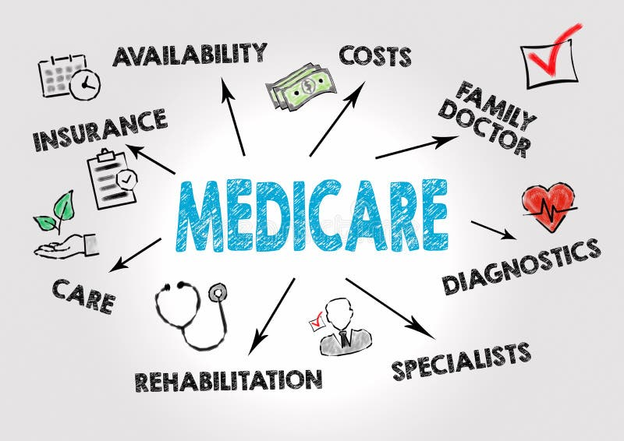
2025
UPDATES

Slide 11
Original Medicare - 2024 Information**
Part A
Benefit Period Deductible: $1,632
Part B
Monthly Premium: $174.70 (2025 Estimated $185.00)
Hospital copay:
$408 (Days61-90)
$816 (Days 91-150)
SNF copay: $204/day for days 21-100
Monthly Premium: Up to $505
Annual Deductible: $240
(2025 Estimated $257)
**Prices for 2025 have not been released yet
Notes:
There is nothing really new in Medicare for Part A & B with the exception of the costs. Part A Premium is always free if you and/or your spouse have worked 40 quarters.
We have not received the 2025 information for B premiums, and Parts A & B deductibles and co-pays. Unfortunately, the estimated price for the Part B premium is a 5.6% increase over 2024, and the COLA is only going to be 2.5%...the lowest COLA in about a decade.

Slide 12

2022 Inflation Reduction Act
And Part D

Slide 13
Inflation Reduction Act Timeline
Negotiation of 15 Medicare Part D drugs
2023
Drug Companies pay rebates
2024
Eliminates 5% coinsurance
2025
$2000 out-of-pocket cap in Part D
2026
Negotiation of 10 Medicare Part D drugs
2027
Insulin $35 cap
Vaccine copay reduction
Part D catastrophic level
Expands LIS eligibility
Delay drug rebate rule
Negotiation of 15 Medicare Part B and Part D drugs
2028
2029
Negotiation of 20 Medicare Part B and Part D drugs
2026‐2029: Implements negotiated prices for certain
high‐cost drugs
2024‐2030: Limits Medicare Part D premium growth to no more that 6% per year
Notes:
The 2022 Inflation Reduction Act is bringing about changes to the Medicare Landscape. In 2023, the price of insulin dropped to $35 and all Medicare approved vaccines are available at no cost. In 2024, catastrophic costs changed, as and all people receiving partial low-income subsidies became eligible for full-subsidies.
The biggest change for Medicare in 2025 with respect to the Inflation Reduction Act is the $2,000 cap out out-of-pocket expenses for Part D. The slides going forward will illustrate this in more depth.

Slide 14
2025 Part D Costs
Coverage Phase | Beneficiary Costs 2024 | Beneficiary Costs 2025
Annual Deductible | $545 | $590
Initial Coverage Limit | 25% of costs until Out-Of-Pocket (OOP) costs reach $5,030 | 25% of costs until OOP costs reach $2,000 (includes deductible)
Coverage Gap | 25% of drug costs until OOP costs reached $8,000 | Not Applicable
Catastrophic Coverage | $0 | $0
What is used towards Out-of-Pocket?
  Deductible
  Co-Pays and Co-insurances
  Certain payments other people or entities make, such as:
    LIS/Extra Help
    AIDS Drug Assistance Programs
    State Pharmaceutical Assistance Programs (Michigan does not have this)
    Indian Health Services
  Supplemental benefits provided by Part D sponsors and certain Employer Group plans
Notes:
RxMOOP includes what you have personally spent (and in some cases**, what other organizations have spent) for Medicare Part D drugs that are included on your Medicare drug plan's formulary (drug list).

Slide 15
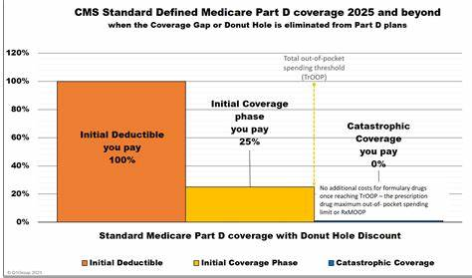
2025 Medicare Part D Phases
2025 TrOOP- $2000.00
$590
Notes:
This slide illustrates how much you will pay for your medications at various points in time. So once you pay $590, you will pay 25% of the cost of medications. Once you hit $2,000, you will not pay anything.
So… if you are paying a maximum of $2,000 out of pocket for your medications, who is picking up the rest of the price? The next slide will provide some detail on this.

Slide 16
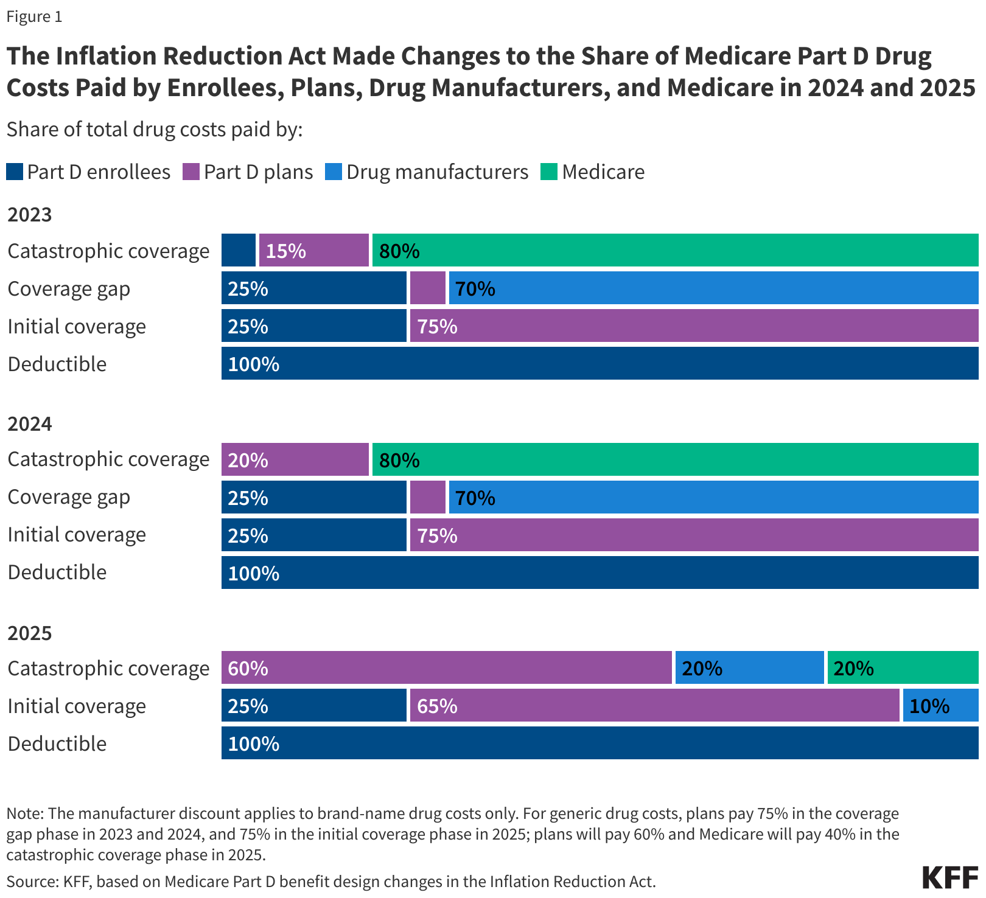

Who is Paying for Medicare Drugs?
Notes:
This slide shows the change over the last 3 years as to who is providing what coverage for prescription medications. The graph with the red circle, beautifully drawn, is for 2025.
Like in 2023 and 2024, you will pay 100% of the cost of medications until you reach the deductible of $590. In 2025, when you enter the initial coverage phase drug manufacturers are now having to pay 10%, reducing the cost to the plans by the same amount.
And, once you reach catastrophic coverage with $2,000 in out-of-pocket expenses, where you would previously pay 20% and Medicare would pay 80%, you will now not pay anything, the plans will pay 60%, the drug manufacturers will pay 20% and Medicare will pay 20%.
Many people will not feel the effects of these changes, but for people who take expensive medications, this can truly be life changing

Slide 17
IMPORTANT!
Only medications that are on your plan formulary count towards out-of-pocket. Over-the-counter drugs do not count, nor do prescription medications purchased without going through your insurance (for example, GoodRX)—even if they are on the formulary
Plan Premiums also do not count towards your out-of-pocket expenses
Plans may choose to not cover medications that are prescribed for
“off-label” use, even if the medication is on the formulary
Notes:
For example, Gabapentin may be on your plan for postherpetic neuralgia, but your doctor may prescribe it for sleep disorders. As this drug is not FDA approved for sleep disorders, your plan may choose to not cover it or may require prior authorization. If the plan does not approve the off-label use of the medication, you will be stuck with the entire cost, and it will not cost towards your $2,000 deductible, or as part of coverage after you meet your deductible. This is just an example.
I will speak more about this a little later when we discuss weight loss drugs.

Slide 18
Medicare Prescription Payment Plan (MP3)
Available to everyone but not everyone will benefit
This allows a beneficiary to spread their Part D payment ($2,000 maximum) out over the course of the year
  Primarily for people with high out-of-pocket costs early in the year
  Process called “smoothing”
It is not a money-saver—just a monthly saver
Payments may increase if new prescriptions are added or if an existing prescription is refilled (up to the $2,000 max)
Medicare.gov Plan Finder has tools to help understand this.
Beneficiaries sign-up for this with the PLAN, not the Pharmacy

Slide 19

Policies sold by private companies
Fills the gaps in Original Medicare
Deductibles, coinsurance, copayments
All plans of same letter have same coverage
Costs are the major difference
Not all plans are offered to people under 65 with a disability
Notes:
Medigap (Medicare Supplement Insurance) policies are private health insurance that cover the policyholder. They are sold by private insurance companies to supplement Original Medicare (help pay for “gaps” in Original Medicare coverage - like deductibles, coinsurance and copayments)
They pay for Medicare-covered services provided by any doctor, hospital, or provider that accepts Medicare
They must follow Federal and state laws that protect people with Medicare.
Some Medigap plans are now offering various riders for services such as vision, dental and hearing. These riders come at a cost to the beneficiary and also come with various restrictions.
The next slide details what different Medigap plans cover. It is important to note that all plans with the same letter must offer the same services at the same percentages. This is aside from any riders they may choose to offer.

Slide 20
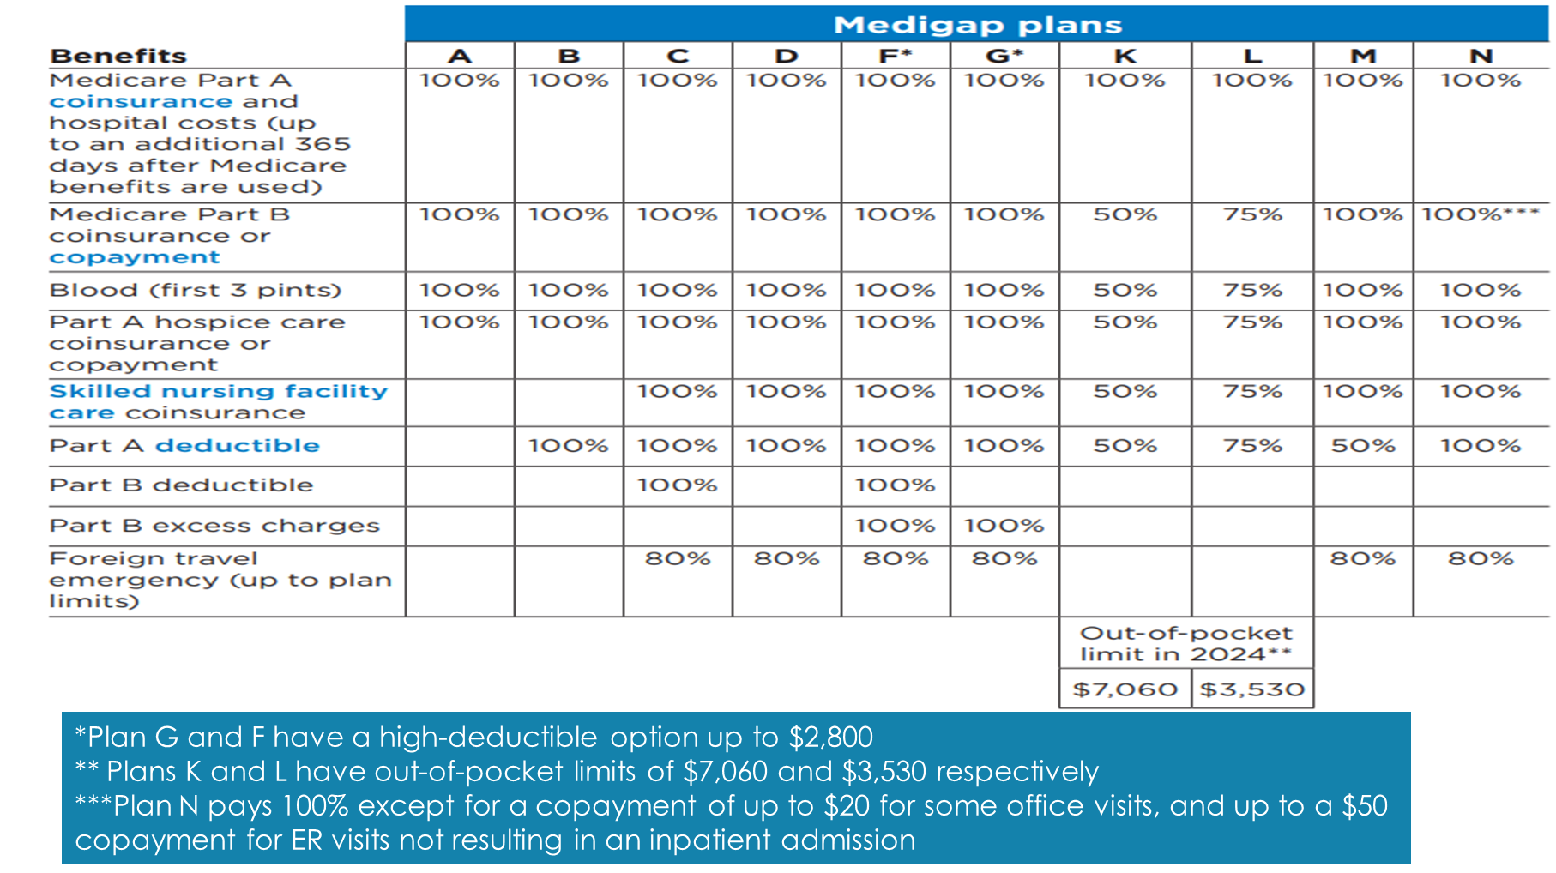
Notes:
There have been no significant changes to Medigap chart graph on page 76 of the Medicare and You 2025 book. Out of pocket limits for K & L plans still show 2024 prices.

Slide 21
Part C Medicare Advantage
MEDICARE ADVANTAGE (PART C)
Health plans approved by Medicare (PPOs and HMOs) run by private Insurance Companies
Includes Parts A & B and usually Part D
Medicare pays amount for each member’s care
Most plans include some dental, vision and hearing coverage
May have to use network doctors or hospitals
Notes:
Medicare Advantage is also called Part C. They are
Health plan options approved by Medicare
Run by private companies
Either an HMO or a PPO
Medicare pays amount for each member’s care
Advantage plans are another way to get Medicare coverage
You may have to use network doctors or hospitals although most PPOs have an out-of-network option. Costs may be slightly higher than the in-network option
It is important to make sure the doctors you choose are in-network, or that your plan has an out-of-network option that you are ok with. And just like choosing a Part D plan, it is essential that check if your medications are all on the plan formularies.

Slide 22
New in 2025
Medicare Advantage Plans must send notice mid-year to beneficiaries of unused benefits, including but not limited to:
Vision
Dental
Hearing
Fitness
OTC-Purchasing Cards

Slide 23
IMPORTANT!
Changing your Medicare Advantage Plan
If you want to change your Medicare Advantage Plan and have added a Dental, Vision, and/or Hearing Rider, you must cancel the rider separately.
  Changing the plan will not cancel the rider.
  You will end up paying for the coverage but will not be able to access it.

Slide 24
Marketing Guidelines
Medicare Advantage and Part D Plans CANNOT:
1 Solicit door-to-door
2 Call people on national and state “do not call” lists*
3 Enroll people over the phone during a solicitation call
4 Offer incentives or gifts exceeding $15, or offer a meal
5 Engage in activities to mislead or confuse
6 Conduct sales presentations or collect enrollment information at health fairs or educational events
Notes:
Plans may not discriminate based on race, ethnicity, national origin, religion, gender, sex, age, mental or physical disability, health status, receipt of health care, claims experience, medical history, genetic information, evidence or insurability, or geographic location. They cannot target Higher Income Areas. They cannot state or imply that plans are only available to Senior rather than all Medicare beneficiaries, or use the term “Free” to describe: Zero dollar premium or Reduction in premiums including the part b buy-down or give-back, reduction in deductibles for cost-sharing
Marketers must clearly indicate what plans/companies they are representing. And, also note that there is a 12 hour break between a marketing event and a sales event, meaning that if you attend a marketing/educational event and like what you see, the presenter cannot sell you a policy on the spot. There must be a 12 hour break between sessions. And what is going to be discussed must be filled out on a scope of appointment form
Plans must include the plan type at the end of each plan name on all communication materials, including marketing material, when the plan name is mentioned.
If you feel you have witnessed a marketing violation or have been misled by a marketer, call us with as much information as you have. We can help.

Slide 25



Third Party Marketing Organizations Must Include Disclaimers on TV/Radio and Social Media Ads
Example:
  “We do not offer every plan available in your area. Currently we represent [number of organizations] organizations which offer [number of plans] products in your area. Please contact Medicare.gov, 1-800-MEDICARE, or your local State Health Insurance Program (SHIP) to get information on all of your options.
  “Currently we represent [number of organizations] organizations which offer [number of plans] products in your area. You can always contact Medicare.gov, 1-800-MEDICARE or your local State Health Insurance Program for help with plan choices.”
Notes:
Third party marketers are, for example the commercials you see with Captain Kirk, Jimmy Walker or Joe Nameth urging you to call and enroll in a plan.
They must have a disclaimer on their ads, however, there is no rule on how fast they can read it.
This slide shows a couple examples of disclaimers that marketers can use. Please note that they need to reference the state SHIP programs!
Please be very mindful if you choose to call the numbers they provide. More than one medicare beneficiary has found themselves enrolled in a plan they did not care to be on. If you hear something that sounds really good, call us and let us know what you are interested in. We will do our best to find you a plan with those benefits.

Slide 26
Medicare Advantage
Special Needs Plans (SNPs)
SNPs or Special Plans are PPOs and HMOs that may offer more benefits (and at possibly a lower cost) to Medicare beneficiaries.
There are plans for people with lower incomes, called D-SNPs (for Dually enrolled Medicare and Medicaid beneficiaries)
There are plans for people with certain chronic conditions, called C-SNPs
  Diabetes and Heart Disease, End-Stage Renal Diseases and HIV/AIDS are a few of the Chronic conditions where C-SNPs are available in Michigan
  DON’T GO IT ALONE! If you are interested in a SNP, it is very important that you educate yourself and talk to a counselor. It can be complicated to navigate the myriad of programs and services that are available. There are also strict rules about applying for, and changing plans that need to be understood and followed.
Notes:
On Medicare.gov plan finder, SNPs are also called Special Plans. The reason is that Medicare wants to insure that people at all income levels know that they are eligible for the C-SNPs if they have a qualifying chronic condition.

Slide 27


Other changes to Medicare
Mental Health and Wellbeing
Medicare is now covering expanded mental health care, such as intensive outpatient programs and services by Masters level marriage, family therapists, & mental health counselors. Talk to your doctor before making an appointment as a referral may be necessary for certain types of services.
Changes to Telehealth Coverage
Starting in January of 2025, some telehealth services will only be offered in rural areas. However, certain telehealth services will still be offered regardless of where you live. Some of those services are:
Mental Health services, including substance use treatment
ESRD home dialysis
Diagnosis, evaluation and treatment of acute stroke
Diabetes self-management training
Medical nutrition therapy

Slide 28

WEIGHT-LOSS DRUGS
Medicare is prohibited from covering medications prescribed specifically for weight loss (or weight gain)
Ozempic is approved by the FDA to treat Type-2 diabetes
  It is also effective as an anti-obesity drug, branded as Wegovy
Medicare covers Ozempic and other GLP-1 drugs as a treatment for diabetes
FDA approved Wegovy to reduce the risk of heart attacks and stroke in people with cardiovascular disease who are overweight
Part D plans may include Wegovy in their fomularies for specific diagnoses, such as Cardiovascular Disease, Stroke and Peripheral Artery Disease
  Wegovy is NOT Medicare approved for weight-loss only. It must have a qualifying diagnosis for it to be covered.
Notes:
This is very important because, if you spend $2,000 on formulary Part D drugs and reach your 2025 RxMOOP - and then purchase an expensive drug (such as Wegovy prescribed only for weight loss, you will end of paying about $1,300 a month—even though you met your max out –of-pocket. It must be prescribed for another diagnosis approved by Medicare. And, if you haven’t met your maximum out-of-pocket yet, the cost of Wegovy just for weight-loss will not count towards your $2,000 maximum. If your doctor prescribes Wegovy for weight loss make sure he or she got prior approval based on an approved diagnosis, or you will end up footing the bill.

Slide 29

Starting January 1, 2025 all Postal Service employees, retirees, and their families will get coverage through the Postal Service Health Benefits Program (PSHB)
If they are Medicare eligible, they must enroll in Medicare Part B to remain enrolled in PSHB benefits unless they meet one of these exceptions:
1. Postal Service retirees who retired before January 1, 2025, and are not already enrolled in Medicare Part B
2. Postal Service active employees who are age 64 or older on January 1,
2025 are not required to enroll in Medicare Part B after they retire
3. Postal Service retirees who are enrolled in healthcare benefits provided by the Department of Veterans Affairs or the Indian Health Services.
There was a Medicare Part B SEP for qualified Postal Service workers (April 1-September 30, 2024). Communications were sent directly to employees and retirees to submit information to SSA.
Many of the plans available under the PSHB will offer cost savings to enrollees such as Part B premium reimbursements, waived deductibles, and waived cost-sharing
Postal Worker Health Benefits
Notes:
If you are a postal worker and believe you are affected by this change, please reach out to us, or your benefits manager through the PSHB.

Slide 30
Low-Income Subsidy (LIS) and Medicaid
Special Enrollment Period (SEP)
January 1, 2025 the Quarterly SEP will be eliminated
New Monthly SEP if you have/are:
    Dual-Enrolled and/or LIS/Extra Help only, you can disenroll from your Medicare Advantage plan, return to Original Medicare and enroll in a stand alone prescription drug plan. You cannot change to a new Medicare Advantage plan
    Full-Benefit Dual-Eligible, you can switch from Original Medicare or a Medicare Advantage Plan to certain D-SNPs
Notes:
For people enrolled in a Medicare Advantage plan, the new “Monthly SEP” will allow individuals enrolled in Medicaid and/or who receive assistance through the Low-Income Subsidy to drop their Medicare Advantage plan, return to Original Medicare, and enroll in a new standalone Prescription Drug Plan on a monthly basis. For individuals already in Original Medicare, the Monthly SEP will also allow individuals to switch from one Prescription Drug Plan to another. The SEP cannot be used to enroll into another Medicare Advantage plan.

Slide 31
Not New But Important To Know

Slide 32
Extra Help/Low Income Subsidy Expansion
In January 1, 2024, Extra Help was expanded to 150% of Federal Poverty Level
Income Limits
$30,660 for married couples
Assets
Include money in a checking or savings account, stocks, bonds, mutual funds, and Individual Retirement Accounts (IRAs).
Does not include your home, car, household items, burial plot, up to $1,500 for burial expenses (per person), or life insurance policies.
$22,590 if you are single
Co-Pay Amounts 2024
People Up to 100% Federal Poverty Level: $1.60/$4.80
People 101-150% Federal Poverty Level: $4.90/12.15
Notes:
If you qualify for Extra Help and join a separate Medicare drug plan or Medicare Advantage Plan with Medicare drug coverage (Part D): • You’ll get help paying your drug coverage costs. • You won’t pay a Part D late enrollment penalty. Most people with Medicare can only switch plans at certain times of the year. 2025 numbers are not out yet.

Slide 33

Special Enrollment Periods (SEPs)
Enable beneficiaries to make Part D changes in special situations, including
  Involuntary loss of creditable coverage
  Entering, residing in or leaving a long-term care facility
  Moving
  Other exceptional circumstances
    Automatic enrollment into a plan by Medicare
    Error by a Federal Employee
    First year trial period for Medicare Advantage
    Switching to/from PACE (Program of All-Inclusive Care for the Elderly)
    When an employer group health plan would otherwise allow a beneficiary to make changes to his/her employer group health plan.
NOTE: COBRA is not considered creditable coverage for Medicare Part B. It may qualify for a Part D Special Enrollment Period, but not in all cases.
Notes:
There are some circumstances in which people with Medicare are given a Special Enrollment Period (SEP).
NOTE on loss of creditable coverage: A beneficiary is not entitled to a SEP if he/she loses coverage due to non-payment of premiums. If a beneficiary was not adequately informed that his/her coverage was not creditable, or that his/her current coverage was reduced so that it is no longer creditable, then the beneficiary will qualify for a SEP.
Other special enrollment circumstances:
There may be reasons why you should take Medicare drug coverage instead of, or in addition to, COBRA. If you take COBRA and it includes creditable prescription drug coverage, you'll have a special enrollment period to join a Medicare drug plan without a penalty when COBRA ends.

Slide 34
A Brief Word About “Creditable Coverage”
Creditable coverage is coverage that is at least as good as what Medicare provides. However, with the $2,000 cap on medications, many businesses may find that the plans they are offering no longer are “at least as good,” as they may have, for example, a $3,000 cap on medications.
To resolve this, CMS has stated that if a plan was considered creditable in 2024, it will still be considered creditable in 2025, so as to avoid a major problem. What will happen in 2026 will be determined later in the year.

Slide 35

Other Things To Know
It is essential to sign up for Medicare ON-TIME
There are life-long penalties that will follow you if you miss the deadlines for Part D and/or B
Part D Late Enrollment Penalty Calculation
Penalty is calculated as
  1% of the Part D base beneficiary premium ($36.78) in 2025)
  For each month a beneficiary does not have creditable coverage and is not enrolled in Part- D (approximately `$0.36 a month x the number of months, added to the monthly premium)
The penalty amount changes each year as the Part D base beneficiary premium changes
Notes:
As an example, if you don’t sign up for Part D for 5 years, you will now have an additional $4.32 a year added on to your Part D premium, x 5 years, which would be $21.60 a month additional added on to whatever premium your plan is charging.
Something we frequently hear is that “I must sign-up when I turn 65 or I will have penalties.” This is basically true, but there are other times people can enroll, depending on their circumstances. A quick conversation with a MMAP counselor can provide you with information on your specific situation.

Slide 36
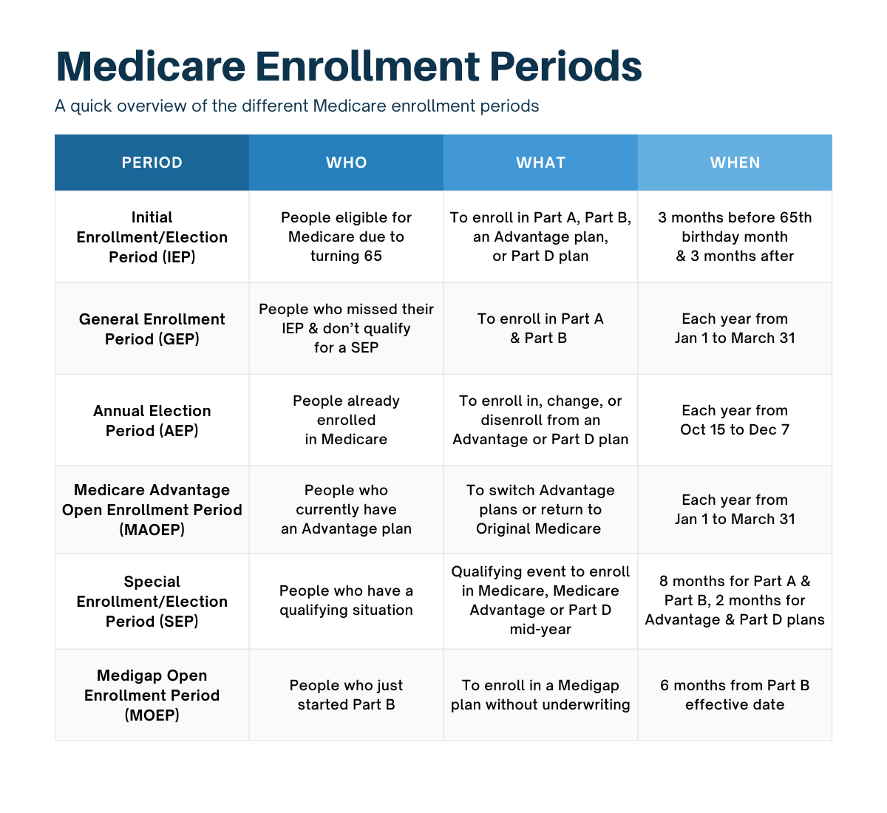



















Medicare.gov/basics/get-started-with-medicare
Notes:
This slide details the different enrollment periods for Medicare. We are currently in the Annual Election Period (yellow) and January-March, we will be in the green Medicare Advantage Open Enrollment period for people who currently have an MA plan and want to change it.

Slide 37

Healthcare Marketplace and Medicare
Marketplace and Medicare not designed to work together
When you becomes eligible for Medicare, you should drop Marketplace in favor of Medicare
If you do not enroll in Medicare, you may:
  Lose tax credits for Marketplace
  Be penalized for not enrolling in Medicare if they enroll later
  If you sign up past your initial enrollment period at age 65, where you are considered “New to Medicare,” you must have proof of Creditable Coverage to avoid penalties
Fresh out of
Medicare Plans!

Slide 38
Income Related Medicare Adjustment Amount
(IRMAA)
Part B & D Premiums are subject to income adjustments
Beneficiaries with significant income will pay a sliding scale higher premiums (based on IRS tax returns from 2 years prior)
  There are 6 income categories
  Each category has a set dollar amount associated with it
For more information on IRMAA call MMAP
Notes:
We can provide you with the 2024 IRMAA charts if you believe you fall into one of the higher-income categories. Also, please note that because the IRS has a 2 year look back, you may be in a position to appeal the IRMAA.

Slide 39
Health Savings Accounts
There are rules regarding Health Savings Account contributions and Medicare
Specifially, if you have an HSA, you must stop contributing to it 6 months prior to getting Part A
You can continue to use the funds in your HSA for qualified medical expenses after you stop contributing
  We suggest that if you have an HSA, you speak with an accountant or Financial Advisor prior to signing up for Medicare

Slide 40
Medicare Plan Finder Star Rating System
Part D plan rating categories:
Drug plan customer service
Member complaints, problems getting services, and choosing to leave the plan
Member experience with the drug plan
Drug pricing and patient safety
Medicare Advantage Plans rating categories:
Staying healthy: screenings, tests, and vaccines
Managing chronic (long-term) conditions
Plan responsiveness and care
Member complaints, problems getting services, and choosing to leave the plan
Health plan customer service
Notes:
Medicare uses a Star Rating System to measure how well Medicare Advantage and Part D plans perform. Medicare scores how well plans perform in several categories, including quality of care and customer service. Ratings range from one to five stars, with five being the highest and one being the lowest. Plans are rated in each individual category. Medicare also assigns plans one overall star rating to summarize the plan’s performance as a whole. A beneficiary can use the overall star rating to compare performance among several different plans.
Medicare reviews plan performance yearly and releases new star ratings each fall. This means plan ratings may change from year to year.
Remember: Before considering a plan’s star rating, make sure the plan’s coverage and costs suit youe needs. For example, if if are considering a Part D plan, be sure the plan covers their drugs at a cost that works for them.
In an effort to promote better plan quality and better choice, Medicare will be sending notices to those who are in a Part D drug plan or Medicare Advantage health plan that fails to get at least a 3-star quality rating for three straight years. The notice lets them know about a Special Enrollment Period to enroll in a 4- or 5-star plan. If you get such a notice and want to consider a new plan, feel free to call us. We provide counseling all year round.

Slide 41
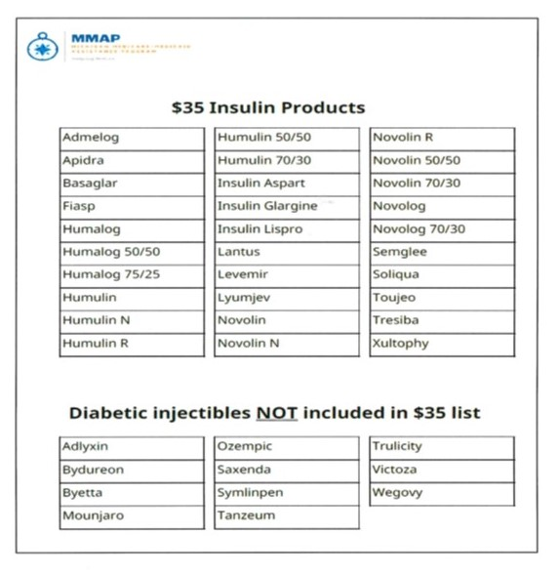
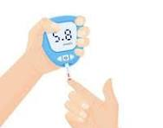
Insulin Products
Notes:
For your reference, here is a list of the insulin products that are capped at $35, as well as a list of diabetic injectibles that are NOT included.

Slide 42



Inflation Reduction Act
Negotiated Drug Prices for 2026 (for a 30 day supply)
DRUG NAME | % Decrease | 2025 | 2026
Eliquis | 0.56 | $ 521.00 | $ 231.00
Jardiance | 0.66 | $ 573.00 | $ 197.00
Xeralto | 0.66 | $ 517.00 | $ 197.00
Januvia | 0.79 | $ 527.00 | $ 126.00
Farxiga | 0.56 | $ 556.00 | $ 178.50
Entresto | 0.53 | $ 628.00 | $ 295.00
Enbrel | 0.67 | $ 7,106.00 | $ 2,355.00
Inbruvica | 0.38 | $ 14,934.00 | $ 9,319.00
Stelara | 0.66 | $ 11,836.00 | $ 4,695.00
Fiasp: Flex touch, PenFill | 0.76 | $ 495.00 | $ 119.00
NovoLog Flex Pen; PenFill

Slide 43

Annual Notice of Plan Changes
Plan Annual Notice of Change (ANOC)
Part D and Medicare Advantage Plans can change their benefits and costs annually
Be sure to check
  Premium, deductible, co-payment changes
  Are your drugs still covered?
  Are your drugs still covered at the same tier?
  Are there restrictions to your drugs?
  Is there another Plan that offers better coverage?
Notes:
You should have received your current Medicare plan’s Annual Notice of Change in September, if you haven’t received it look for an envelope from your insurance provider and note that it may be on thinner paper.
Note: Plans cannot change coverage midyear

Slide 44

What help is there for people with limited income and/or resources (and for people who just want to save money**)?
Extra Help (with prescription drugs)
Medicaid
Medicare Savings Programs
Pharmaceutical Assistance Programs
Prescription Savings Cards**
Notes:
There are programs available to help people with limited income and resources pay their Medicare costs. These include Medicaid, Extra Help, and Medicare Savings Programs. If you think you might qualify or need help, call MMAP and we will set up a private appointment with you.

Slide 45


A Few Words About
Fraud and Scams
Medicare Fraud is the most common scheme affecting seniors
Examples:
  Medicare/Medicaid is billed for services you never received, equipment you never received or was returned
  Someone uses your Medicare/Medicaid card
  A company uses false information to mislead you into joining a Medicare plan

Slide 46

Calls asking to verify your Medicare # so you can get a plastic card
Calls offering you rebates on certain services
Calls indicating that your Medicare plan is being terminated
Calls offering you a wellness exam (and they will notify your doctor)
Often the caller will be insistent on immediate action or payment. These calls can be quite scary.
Notes:
Chek your all your EOBs and MSns to make sure the all the charges are legitimate. Sometimes a fraudster will get hold of your # and bill medicare for something you did not get or need (currently the big scam is urinary catheters). If you don’t look at your notices, you won’t know because you aren’t getting billed for anything, but Medicare is. And, when Medicare pays, we all pay.

Slide 47
To Report Fraud or Scams
MMAP
1-800-803-7174
SMP Hotline
1-866-642-4767
Do not be afraid or embarrassed to report if you have been a victim of a scam. The scammers are very tricky! It can happen to anyone.

Slide 48
We Are Here to Help You
1-800-803-7174 or MMAP@ageways.org
If you want to speak with a MMAP counselor about your specific situation, give us a call
Our service is confidential and unbiased
We counsel currently over the phone, Zoom and in-person where available
No question is too trivial, and we often deal with very complicated questions as well
Notes:
We are out in the community during now through December 7th, and have appointments available.

Slide 49

Funding Statement
The Michigan Medicare Assistance Program (MMAP) is a part of the national network of State Health Insurance Assistance Programs (SHIP) and Senior Medicare Patrols (SMP). Funding for MMAP is supported by grants from the U.S. Administration for Community Living-Department of Health and Human Services and the Michigan Department of Health and Human Services, grant numbers: 90SAPG0090, 2101MIMIAA, 2101MIMISH, and 90MPPG0039. Points of view expressed do not necessarily represent the Administration for Community Living or Michigan Department of Health and Human Services. MMAP does not receive funding from, nor is it affiliated with any insurance companies.
www.mmapinc.org

Slide 50


Slide 51


Nonprofit with a wide variety of programs, services and supports to help older adults and their families in our 6-county region
Serve: Livingston, Macomb, Monroe, Oakland, St. Clair and Washtenaw counties
Two separate Area Agencies on Aging serving SE Michigan designated for Wayne county
Helping Seniors and Their Families
Contact us by:
www.ageways.org
800-852-7795

Slide 52


Programs That Can Help:
Information and Assistance
Free phone help line for seniors and their families
Help guide seniors and family members on understanding home and community-based services
First place to call when you or a loved one need assistance
800-852-7795

Slide 53

Shari Smith, MA, MPH
MMAP Manager/Regional Coordinator
MMAP@ageways.org

