Slide 1
Dementia Conversations: Communicating with Empathy and Understanding
J. I. Mangi, PhD
Chair, Dementia Friendly Saline
And
Volunteer Community Educator, Alzheimer’s Association
jim.dfsaline@gmail.com

Slide 2
Connecting Throughout the Dementia Journey?
      Yes You Can
      Perspective
        16+ years
        Even now
      Adapted from Alzheimer’s Association, NIH, et al)
Notes:
I like this subtitle better
Positive message, yes you can
Skip slide telling you the things you need to be able to list in order to pass the quiz at the end---there is no quiz. Just real life.
16 years of hindsight
Adapted from

Slide 3
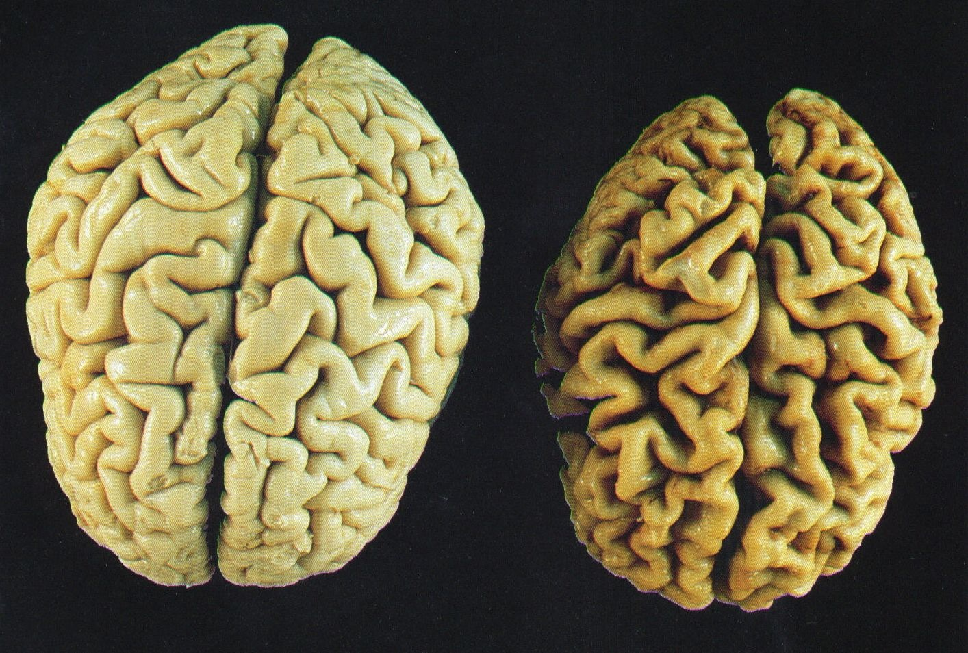
What is “dementia”?
General term—troublesome memory and thinking problems
Mostly caused by brain diseases, e.g. Alzheimer’s
75 yr old brain w. Alzheimer’s disease
75 yr old brain
Notes:
Way its used today
Far more than occasional oh shucks
True interference
Usually true damage

Slide 4
The Dementia Journey
Early Middle Late
8-10+ years
Changes in:
Abilities
Communication
“Behavior”
Notes:
Different diseases,
Mostly slowly progressive
All cause

Slide 5
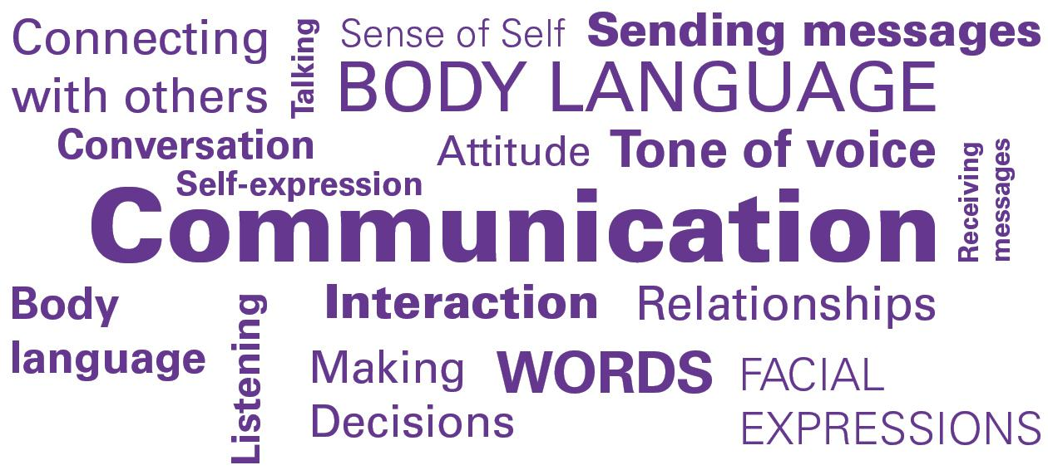
Communication Mix
Touch
Gestures
Music
Movement---
Dance
Food
Notes:
its always mixed
the mix changes
need to adapt along the way
abilities change along the way

Slide 6

Communication Effectiveness
Non-verbal: body language
Verbal: words and word choices--- spoken or heard
“I’m fine”
Para-verbal: tone, pace
Notes:
Maybe can relate to this example of loud communication other than with just words.
(sometimes contrary to words)
“Actions speak louder…”
So gotta raise awareness of more what we say

Slide 7
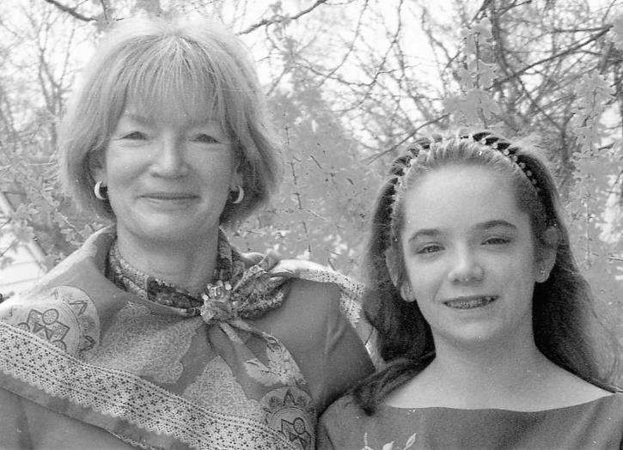
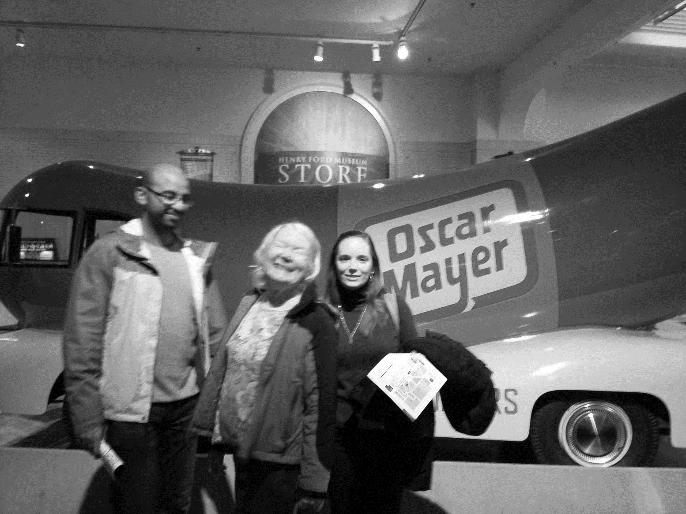
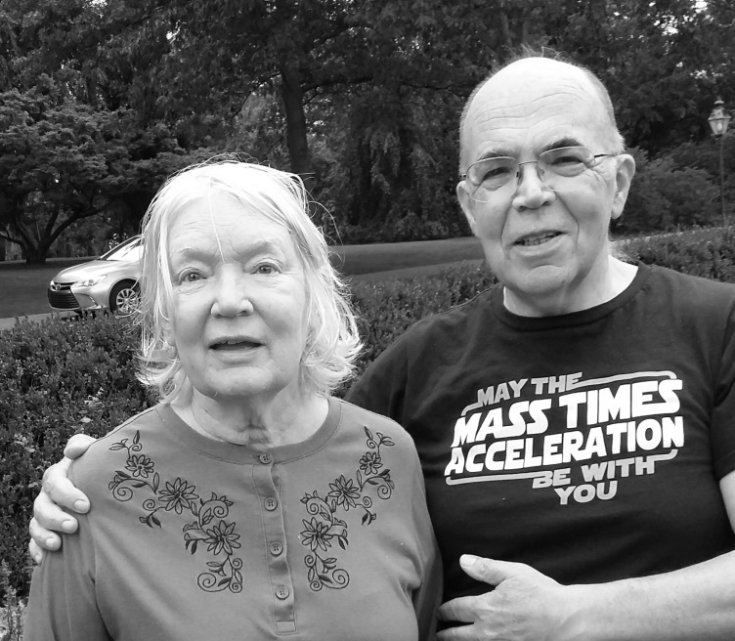
A Continuum of Abilities
Early Middle Late
Independent w. barely noticeable difficulty
Substantial help required
Different Stages--and strategies
Wide variations between persons
If you’ve met one person with dementia…
Notes:
No bright lines nor consistency

Slide 8
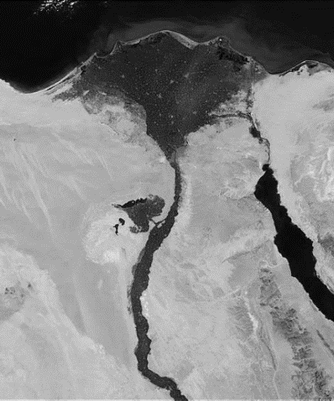


Early Stage Difficulties
Repetition
“Not paying attention”
Delayed response
Confusion
Anosognosia
Unreliable Recording Equipment
The Egyptian River
Notes:
Frustrating
Gotta remember, in part
Maybe physiological
Maybe psychological for them
And for you
It’s a seismic change

Slide 9

Connect, don’t Correct
“She has to get it right”
“Don’t you remember?”
Heed Paul McCartney’s words
Interrupt only if…..
Close enough….
It’s about respecting, not inspecting
Notes:
YOU want things to be right
YOU want them to remember
Let go of how it was
Let It Be
If you don’t…

Slide 10

Talk TO not about
Hey! I’m right here!
He’s very cranky today
It’s not like him
They will notice
the disrespect
Pay attention to non-verbal channels
Notes:
Lots of talk about inclusion
Easy to exclude
Not hard to include

Slide 11

Learn to…
Keep
It
Short
Simple
Slow
Notes:
Short sentences. So they don’t lose the subject before the verb
One idea at a time
A bit slower delivery
And give time for response

Slide 12

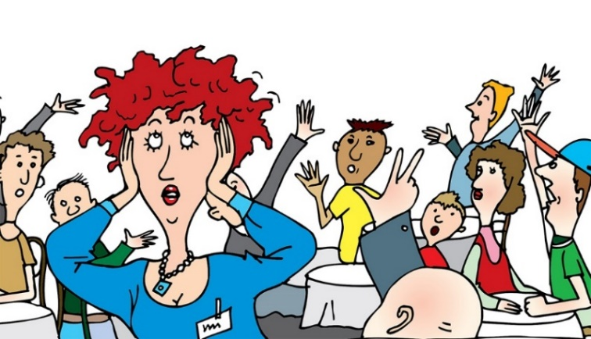

Connection Tips
Lessen distractions
Back-check—”if I understand you right….”
Use para-verbal and non-verbal reinforcements
Notes:
Yes, every TV has an off switch
Know that clutter –both sound and visual—can be hard to cut through
Use natural gestures

Slide 13
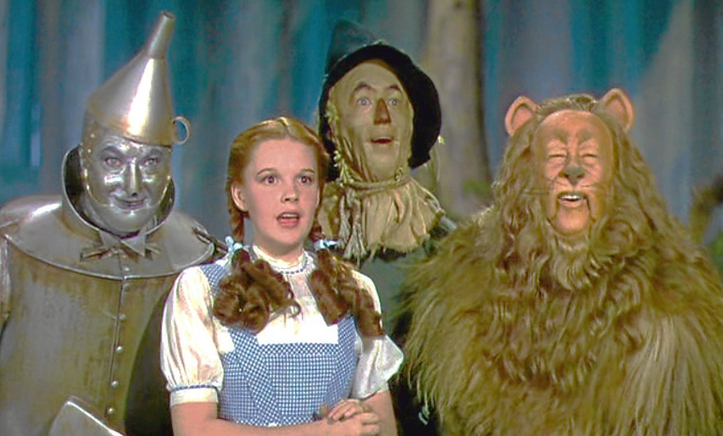
In The Middle of The Journey
Stuck in a new, strange, scary world
“Here” and “Now” aren’t
Notes:
Nothing just happened----”distant” events are current
Not “remembering” childhood, re-living it
Can’t join, can’t cajole them back here
Re-assure

Slide 14
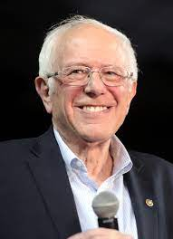
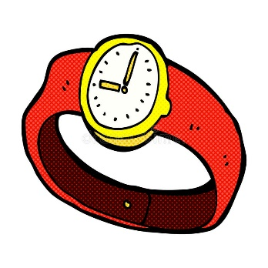

Middle Stage Difficulties
Word finding & substitutes
Prolonged repetition
Incomplete sentences
Very delayed response, or none

Slide 15
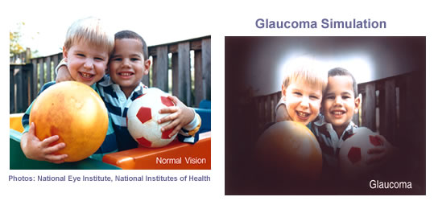


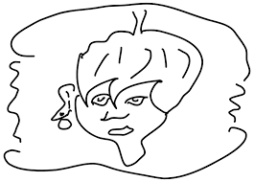


Middle Stage Tips
  In front, eye level (field of view)
  Avoid negatives
  Respect their reality
“There’s some old lady in the bathroom
Bat B Gone
Notes:
Eye to eye, respect and puts you in their restricted field of view
More comfortable if…
Don’t argue, just act and assure

Slide 16
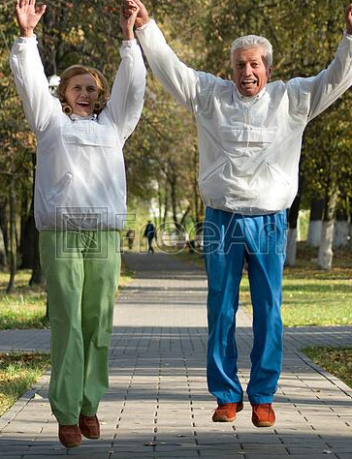



Careful With Your Words
  Figuratives
  Short notes, easy icons
Brush teeth
Notes:
Avoid figurative language like “just a second” (“take your hand” or “hop on over here”)
Don’t assume readability of paperwork, or usability of screens

Slide 17
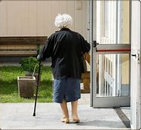
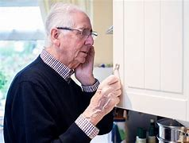

“Behaviors”?
Communicating thru actions
  “Wandering”
  Agitation
  Rummaging
Always a message, a reason
Not always clear, “logical”
Seek the reason
Respond to the message
Notes:
Behavior---a value judgement
It’s the disease
Never random, but seldom obvious
Look for reason
Address it

Slide 18
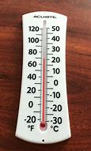
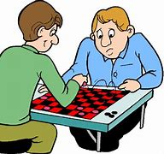
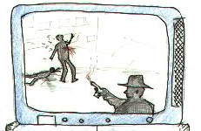
Some Causes of “Behavior Changes”
Altered perceptions
“Unfamiliar” setting
Physical discomfort
Frustrating activity
Emotional upset
Notes:
“Familiar” places aren’t
Too many tasks, steps
Upsetting events on TV

Slide 19
What Behaviors Could Mean
“Wandering”: seeking---
  childhood home
  family member
  a snack
  the bathroom
Connect
Detect
Respect
Redirect
Lovingly lie
Go with flow
Fidgeting:
  Pain
  Boredom
  Frazzled
Notes:
Realize there is a reason,
Root cause may or may not be obvious
Keep trying
Re-assure, work with them, not scold

Slide 20
Much Later In the Journey
Words gone---not the person
Still taking it in, so
Your words, your non verbals matter
Other senses too
Notes:
Greatest tragedy

Slide 21
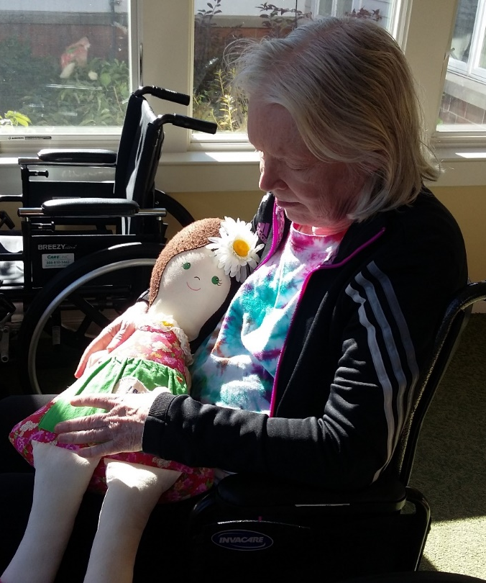


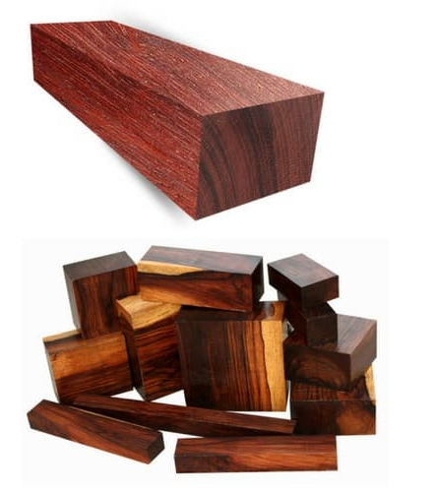
Late Stage Connection: Touch
Human
Friends
Fabrics/objects
Notes:
Human touch---
Gentle touch for a change
Be creative

Slide 22
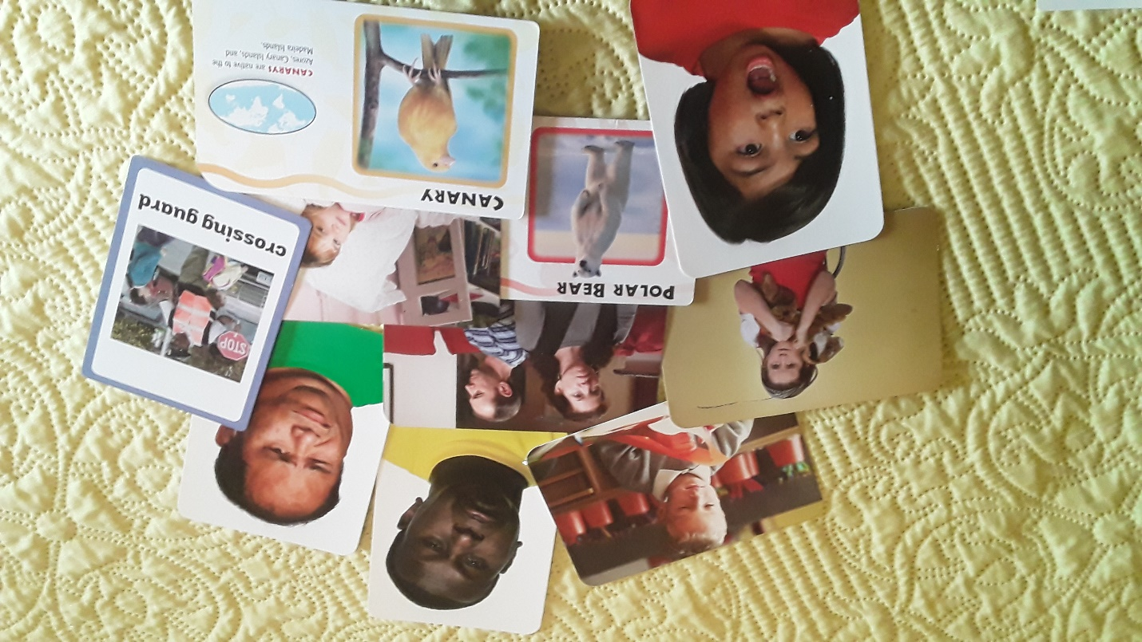

Late Stage Connection: Visual
  Not fussing over photos
  Picture cards, books
Notes:
Not just old family photos

Slide 23

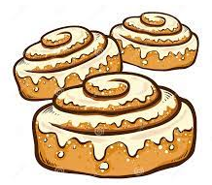
Late Stage Connection: Aroma, Taste
  “Samplers” of
    Herbs, spices, oils, flowers
    Teas, or coffee beans.
    Be careful!
  Fragrant hand lotions
  Fragrant, memorable foods
  BUT, things change
Notes:
Again, be creative AND careful
Try lots of things

Slide 24
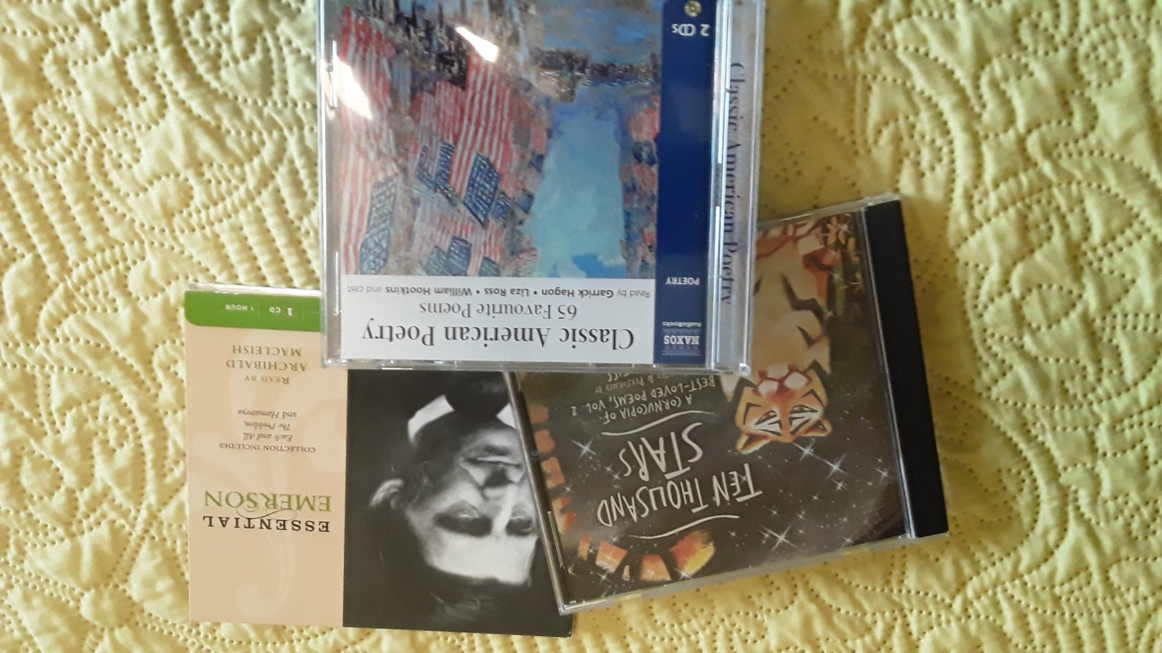
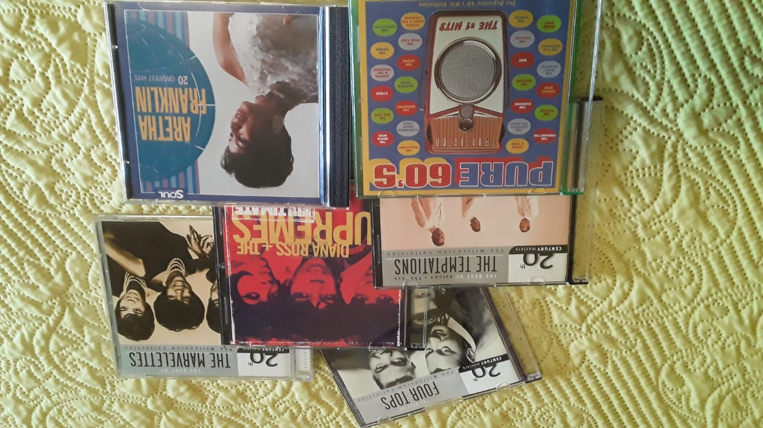
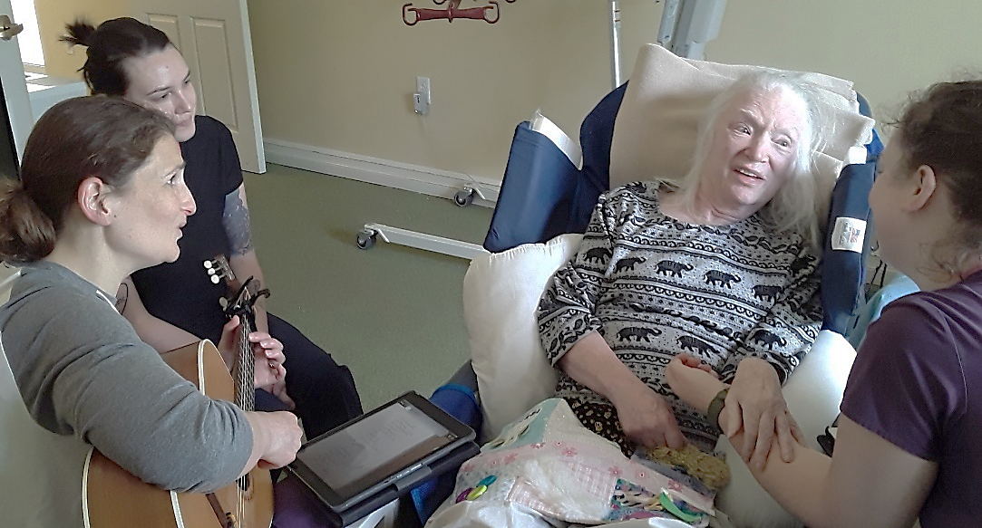
Late Stage Connection: Sound
  Poetry
  Music
Notes:
Recorded Robert frost etc.
Motown memories

Slide 25
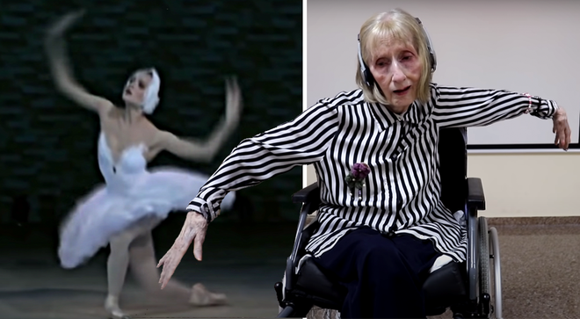
Enduring Power of Music
Google: “Alzheimers + Ballerina”

Slide 26


“Speaking without Talking”
They’re there
Still connecting
  Birthday
  Chocolate

Slide 27
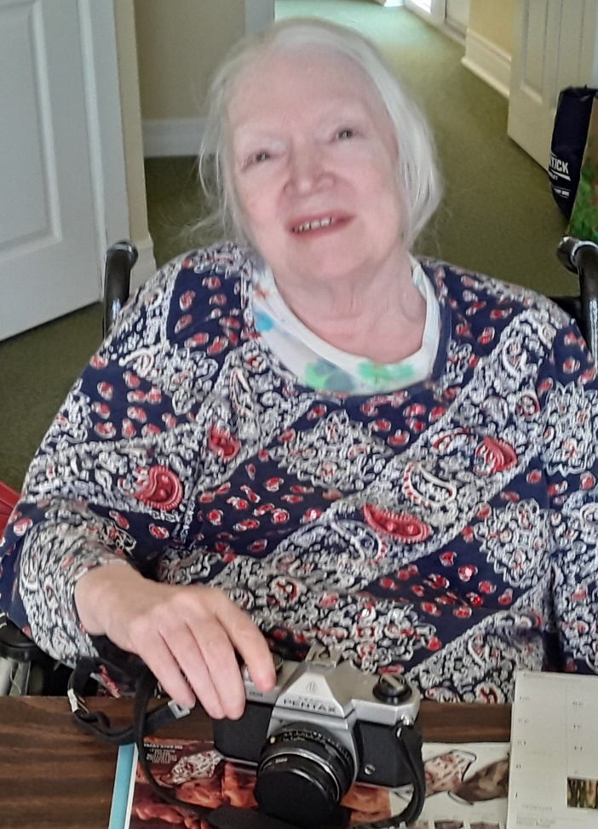
Until The Last
  A Person
  To connect with
  You’ll be amazed
  Nat King Cole got it right

Slide 28

Your Turn
Thank You!
Notes:
Your questions
Your suggestions for topics that you want to hear about next week

