Slide 1
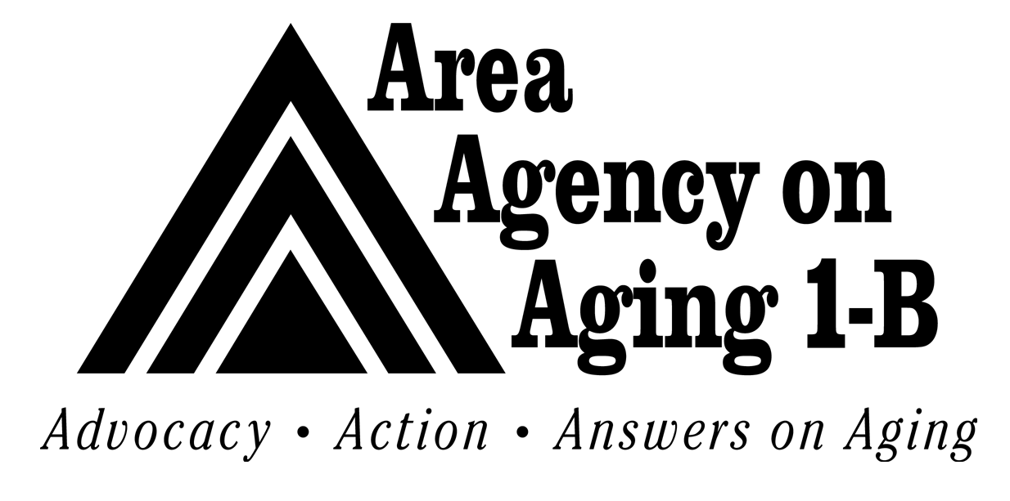
FINANCE COMMITTEE
2022 Budget presentation
August 20, 2021

Slide 2
AASA Program – 2022 Highlights
Due to the uncertainty with the State budget, we are budgeting no increase in AASA funding for FY 2022
Based on this level of funding we are targeting AASA enrollment at 1,000 participants.
We estimate $800,000 in carry over funds from fiscal year 2021 to fiscal year 2022. These funds will be utilized in reducing the time between enrollment and delivery of services.

Slide 3
MI Choice Program – 2022 Highlights
The Agency has seen enrollment growth in FY 2021 of 20% from 763 to 910 participants and expect this trend to continue into FY 2022. The current wait list as of July is 335 compared to 649 in Oct 2019
The State will increase per participant rates for FY 2022 by 1.6%
The risk pool fund has been increased from $6 million to $8 million for FY 2022
The growth in enrollment is a favorable trend for the Agency, but participant service costs remains one of the largest factors effecting expenses for the program

Slide 4
MI Health Link Program – 2022 Highlights
The MI Health Link program is a five-year pilot program that began in FY 2016, The State of Michigan is considering renewing this pilot for another five years
This budget includes another year commitment to the program which will operate at a $60,000 deficit
The Agency currently works with four Integrated Care Originations (ICO’s) and during FY 2021 the Agency initiated contract discussions with each. It is our goals to renegotiate these contracts to remove the finance losses to the Agency.

Slide 5
Fee For Service Programs – FY 2022 Highlights
Veterans Administration Program – We have seen growth in this program from 42 participants to 58 in FY 2021. We are budgeting at this level for FY 2021 and look for opportunities for further expansion.
Total Health Contract – In our discussions Total Health is not expanding at this time so we are budgeting at current levels.
McLaren Contract – We are in discussion with McLaren to expand the services we provide under this contract. At this level the contract may not be worth continuing.

Slide 6
Grants – FY 2022 Highlights
MMAP Grant – The Centers for Medicare and Medicaid Services grant does not cover all the cost of this program so the Agency is seeking other grants to support the program. We have already received a commitment from Filmer Memorial Charitable Trust to support the MMAP program
Mobility Management – This is a reimbursement grant from SMART
Refugee Grant – The Refugee Assistance for Older Refugees grant is funded by LARA, Michigan Office of New Americans to provide access to community services and resources and reduce social isolation for refugees over age 60. A small amount of this grant supports the salary of the grant manager; the remainder is subcontracted to American Ladies of Charity.

Slide 7
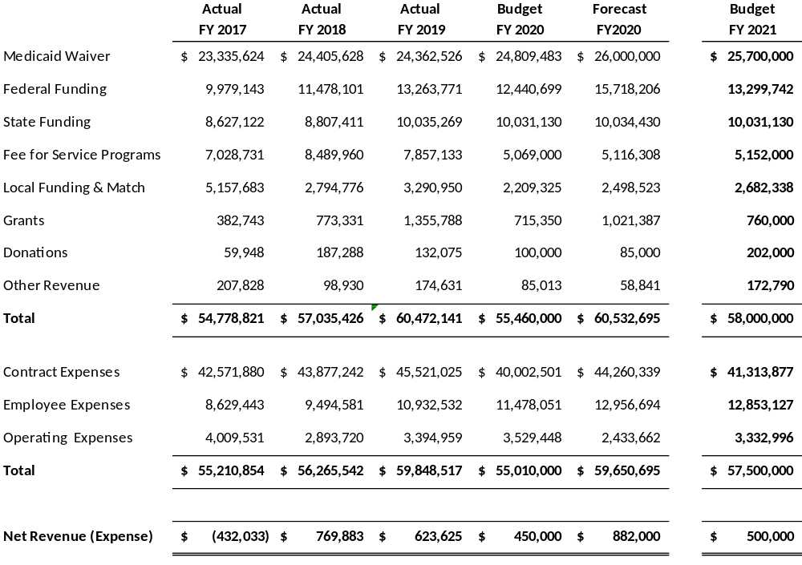
Summary Budget

Slide 8
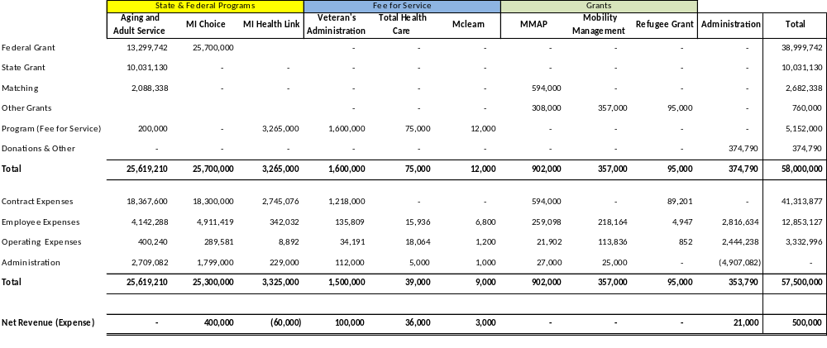
Agency Budget By Program

Slide 9
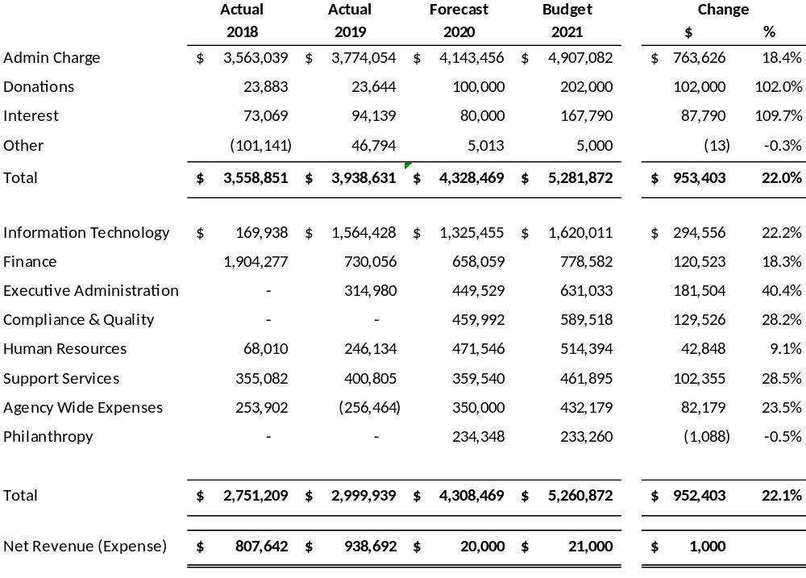
Administration Budget

Slide 10
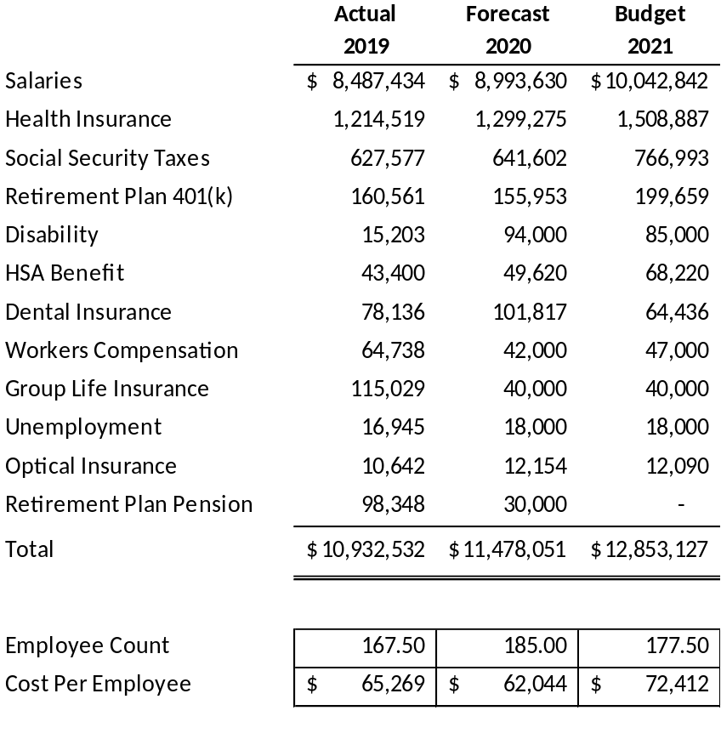
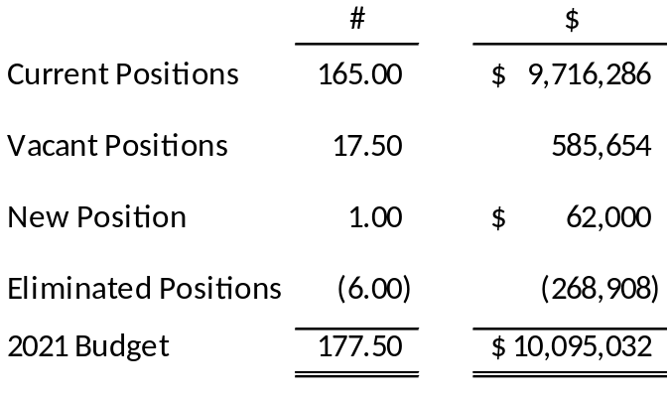
Employee Expenses

